Slide 1




Our Digital Strategy
2024 - 2030
www.southwestyorkshire.nhs.uk

Slide 2

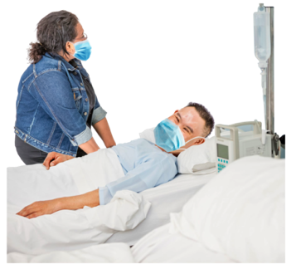
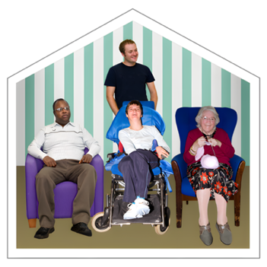

About us
We are South West Yorkshire NHS Foundation Trust. We run health services in South West Yorkshire.
Our services include
health care in hospitals
helping people at home
support for children and adults with learning disabilities, autism and ADHD
ADHD means Attention Deficit Hyperactivity Disorder
help to stop smoking and to stay fit and well
2

Slide 3
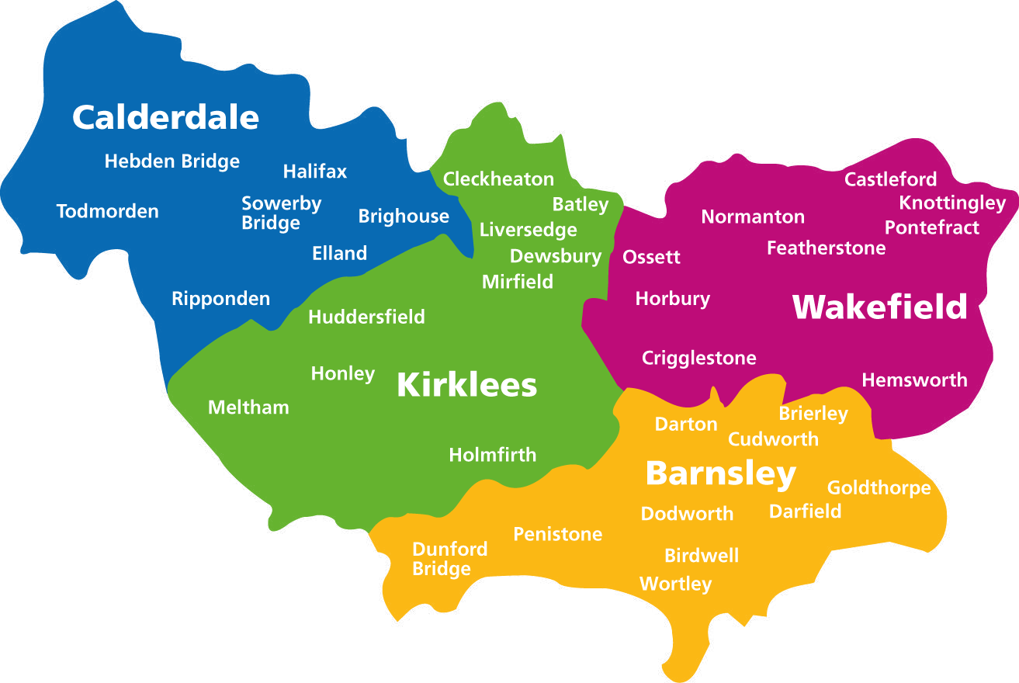
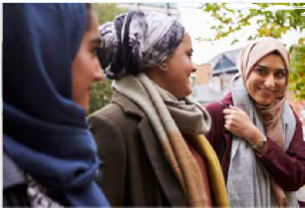

People we help
We help people in Calderdale, Kirklees, Barnsley and Wakefield.
There are 1.3 million people living in these places.
We also employ 5400 staff.
3

Slide 4


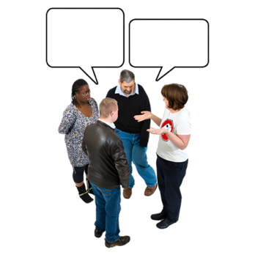
Our Digital Strategy
Digital means using computers, tablets, phones and other technology.
We use them to
collect and store information about patients
organise and share the information
communicate with each other
plan people’s care
This Strategy is our plan for how we will use digital technology to give people better health services.
4

Slide 5
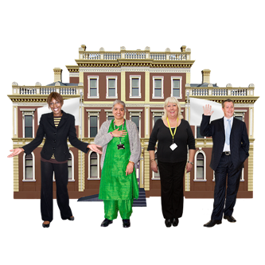



Partnerships
Our partners mean other organisations we work closely with.
Working closely means our staff work together to give people the best support possible.
We have partnerships with
NHS organisations
Councils
Healthwatch
Hospices
Charities
Community groups
5

Slide 6
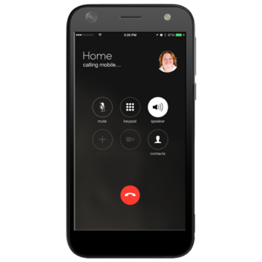
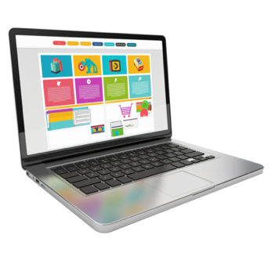
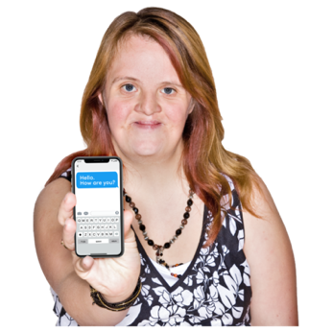
What people told us
When we make plans, we listen to our staff and to local people.
Local people told us about digital technology. They said
We need to have phones and laptops, and the skills to use them.
We need enough mobile data to get online – and help with this if we don’t.
We need appointment reminders by text message are helpful.
Don’t stop face-to-face appointments
6

Slide 7
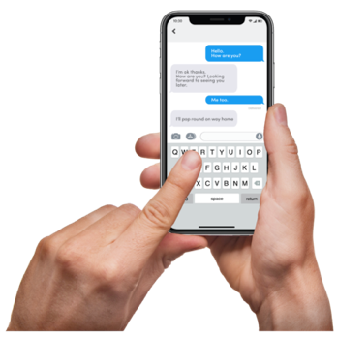
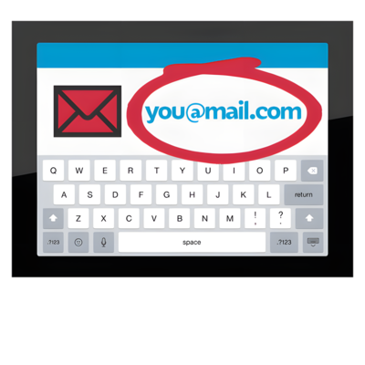

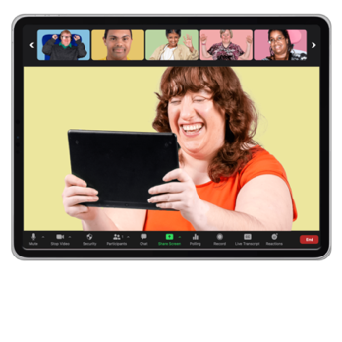
Our staff told us about digital technology. They said
Smartphones help me do my job.
We need more training about things like spreadsheets and how to manage email.
We need the right equipment for working in shared offices.
We need more office space for private online meetings.
Digital skills should be part of the training for all new staff.
7

Slide 8


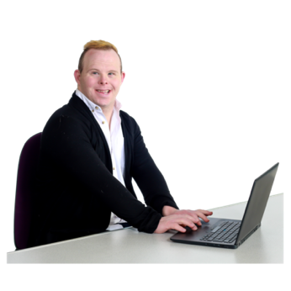
Our digital technology
We have been using digital technology for a long time.
We already have strong and reliable digital technology systems.
Over the last 3 years, many more of our staff have everything they need to
work from anywhere
get online
find all the information they need
8

Slide 9



Our vision
Our vision means what we want to make happen using digital technology.
We want digital technology to help us to
keep changing and getting better, so we can care for more people, in the best possible ways
find problems as soon as we can so we can fix things before they get worse
choose the most important jobs to do first
make sure we use our money and resources in a good way
9

Slide 10



Our plans
We want to tell you about what we will do, for each of these things
Accessibility
Our staff
Using information
Sharing information
Care Records
Security
Infrastructure
Infrastructure means:
computers, smartphones, tablets and places to store information
the ways we connect all these things together
10

Slide 11


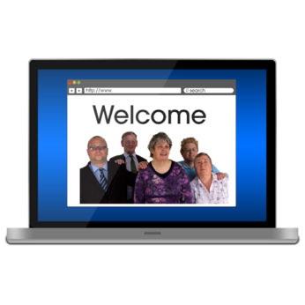
1. Accessibility
Using digital technology can leave some people. For example, if they
don’t have a smartphone
Can't use a computer
don’t have a good internet connection
worry about how their personal information is being used
We will make sure our website and other digital services are easy to use.
People will still be able to choose how they want to get information and how to contact us.
11

Slide 12

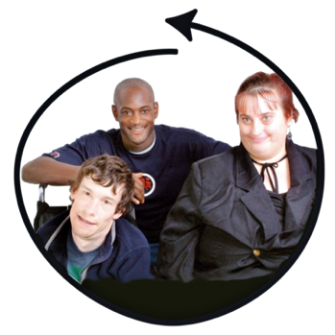
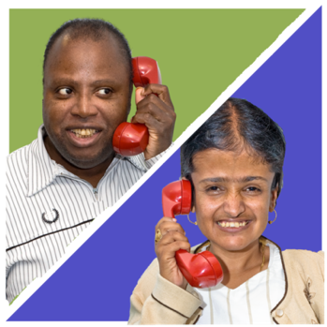
Examples of accessibility
We will
help people learn how to use digital technology
involve staff and local people when we design new digital services
use the digital information we have to learn more about the difference our health care makes
make it easier for patients to contact our staff and have online appointments
make it easier for patients to see their own records
12

Slide 13



2. Our staff
Our staff need the right equipment and the right skills, to make the most of digital technology.
Our staff need
Good connections to our computer systems, wherever staff are working
Good training
Tell staff to help each other to learn new digital skills
Involve staff when we design digital systems
13

Slide 14
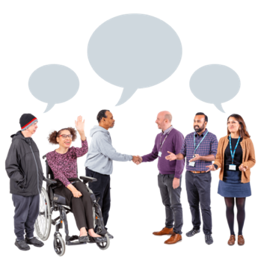


Examples of what we will do for our staff
We will
work together to find new ways to use digital technology
give staff the equipment they need
use digital technology to give our patients better care
find out about the training that our staff need
test new technology, to see how well it works
14

Slide 15

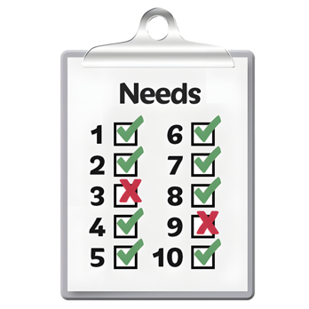

3. Using information
We collect information about our work.
We want to improve the way we use this information to:
decide on the the amount and type of care people will need in future
make sure our services are good quality
learn more about the people we help
This work will help us learn more about our local area and the people who live here.
15

Slide 16


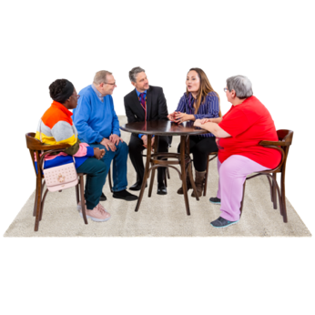

Examples of how we will use information
We will
Make a range of reports which are helpful to the people reading them -
from Board members to ward staff.
Make information easy to find and easy to understand.
Make sure that the information we collect helps us to make services better.
Update the ways we store information.
Make sure the information we use is correct.
16

Slide 17
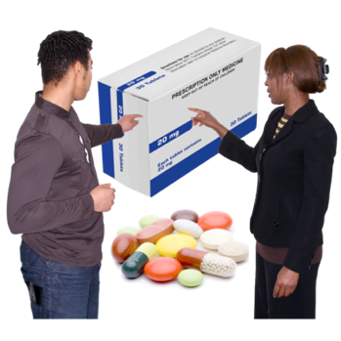

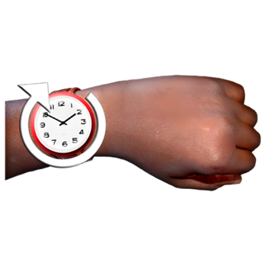
4. Sharing and storing information
We store the information we keep in a safe different places
For example:
Information about patients – where they live, test results, treatments and more
Appointment lists
Waiting times
It is important our staff can find the right information quickly.
We also need to make sure the people who get the information are allowed to see it.
17

Slide 18
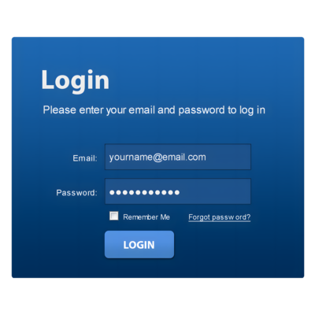


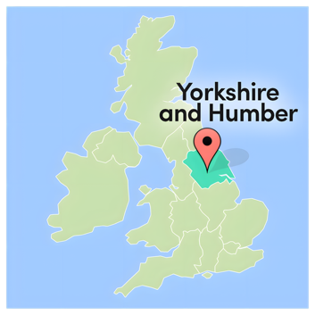
Examples of how we store and share information
We will
Make a portal – this is a web page where people can go to get the information they need.
Work with other organisations in our area to improve how we share information.
Make sure we follow strict rules and agreements when we share information.
Carry on helping to build the Yorkshire and Humber Care Record. This stores information about people’s care.
18

Slide 19
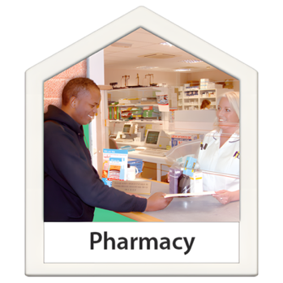


5. Care Records
The information we keep about people’s care is important for all our work.
This is called our Care Record.
Our Care Record us to:
prescribe medicines
support people at home
store and read documents about people’s care; letters, reports and more
give patients information about their care, so they can be involved in making decisions
19

Slide 20



Examples of care records
We will
Keep making our care record system better so it works well for everyone.
Give staff the right training to use it well.
Make sure staff can safely and quickly access and update care records wherever they are.
Make sure every change we make is guided by safety and good practice.
20

Slide 21


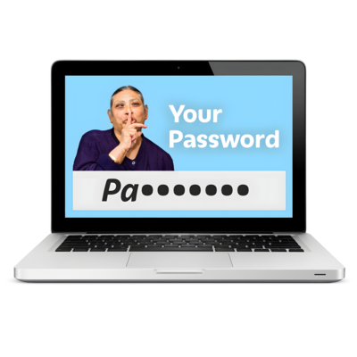

6. Security
Cyber security means keeping computers, phones, and other devices safe.
It keeps the information stored on them from being stolen, lost, or damaged.
It stops people getting into systems when they should not.
Things that help with security include:
good passwords
keeping safe from computer viruses
keeping computers, laptops and other equipment safely locked away
training our staff to know how to keep things safe and secure
21

Slide 22


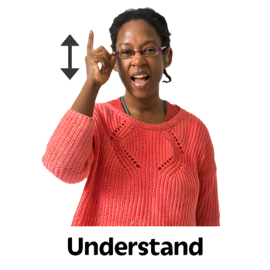

Examples of security
We will
Check and improve our cyber security regularly.
Follow national rules for data security and keep good records about how we do this.
Help staff to understand what they need to do to keep our systems safe.
Take action fast if we get any threats or warnings
22

Slide 23


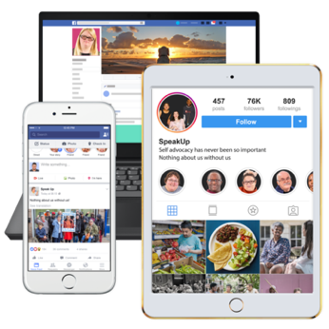
7. Infrastructure
Infrastructure is the technology we need to store, share, and use information.
This means
Computers, phones, and tablets.
Internet and Wi-Fi connections.
Computer programs and apps.
Information storage systems.
Security systems to keep information safe.
23

Slide 24


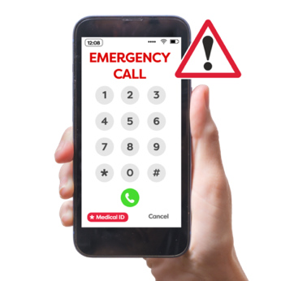
Examples of infrastructure
We will
Plan for the next 5 years so our digital systems stay strong and up to date.
Keep replacing systems and equipment to make sure everything works well.
Look after all our equipment and networks so they are safe and reliable.
Test our emergency plans every year.
Check our software licences and contracts every year to make sure we follow the rules and get the best service.
24

Slide 25


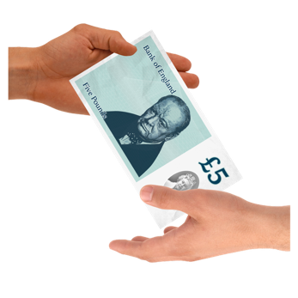
Our money
We spend money on digital technology in 3 ways
Keeping things working well, fixing problems and making plans.
Making things better, improving our systems and changing how we work
Trying new ideas, new technology and new ways of working.
We spend more money each year on digital because it is becoming more important.
How much we can do depends on how much money we have.
25

Slide 26
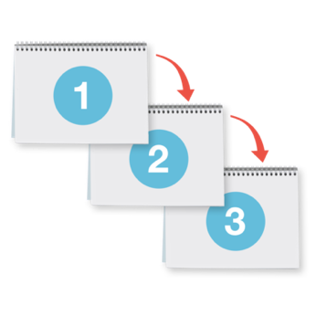
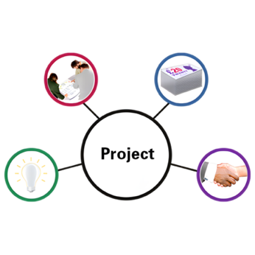
Making our plans happen
Our Board make sure that what we say in this strategy gets done.
They will check we make real changes to the way we use digital technology. This helps to care for our patients.
The strategy will be divided into yearly plans and smaller pieces of work called projects.
People will be responsible for running the projects.
They must report to the Board about what has been done, and when.
26

Slide 27

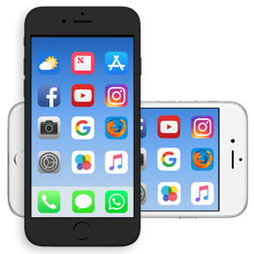


Getting in touch
Address
South West Yorkshire Partnership NHS Foundation Trust
Fieldhead
Ouchthorpe Lane
Wakefield
WF1 3SP
Phone
01924 316000
Email
customerservices@swyt.nhs.uk
Website
https://www.southwestyorkshire.nhs.uk
27
27

