Slide 1
KO: To care about other people's feelings and to try to see things from their points of view.
I can define a stammer
I can state how others might feel
I can support someone with a stammer

Slide 2
How important is communication? Could you live without communicating?

Slide 3
What about if your communication was different? What if you received unkind responses when you spoke?
Let’s see…
With your partner, number yourself 1 and 2.
Number 1 – pick up a reaction card
You are going to have a conversation all about your favourite food.
Number 1 – You will ask many questions about number 2’s favourite food.
Number 2 – You will answer
Number 1 – as number 2 is talking, use your reaction card to respond
Now swap roles.

Slide 4
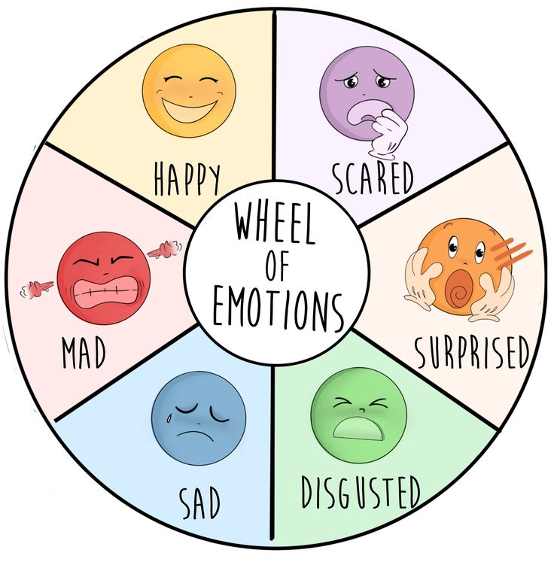
Reflect…
How did this make you feel?
When might someone feel like this?

Slide 5
The Boy Who Made Everyone Laugh by Helen Rutter

Slide 6
What is a stammer?
Stammering is when:
you repeat sounds or syllables – for example, saying "mu-mu-mu-mummy"
you make sounds longer – for example, "mmmmmmummy"
a word gets stuck or does not come out at all
Stammering varies from person to person, and from situation to situation. Someone may stammer more than others, some might have periods of less stammering followed by times it increases
Stammering can also affect how someone feels on the inside

Slide 7
Who is affected?
Studies suggest around 1 in 12 young children go through a phase of stammering.
Around 2 in 3 children who stammer will stop stammering, although it's difficult to predict who and when.
It's estimated that stammering affects around 1 in 100 adults, with men being around 5 times more likely to stammer than women.

Slide 8
How to support someone with a stammer?
When talking to someone who stammers, try to:
avoid finishing their sentences if there words are stuck
give them enough time to finish what they're saying without interrupting
avoid asking them to speak faster or more slowly
show interest in what they're saying, not how they're saying it, and maintain eye contact
How could you be a good friend to someone who stammers?

Slide 9
A letter to Billy What would you tell him?
Letter Activity
Dear Billy,
I can’t believe that I am writing a letter to you about this. Be kind! Everyone should always be kind. You should never feel that your stammer is a limitation in your life. It saddens me that you have people around you who make you question who you are. How dare they! They should be ashamed. Some people might see a stammer as something to laugh and joke about; others see it as a cause to be proud and celebrate. I stand with the latter! I want to reassure you that you can do anything you put your mind to.
When I consider your stammer, I see that this simply makes you special. I know you sometimes struggle to get out your words or it may take a little longer to say a word, but does this not mean that each of your words are more valuable as you have put more effort into each and every word? To me, each word has more meaning and therefore more reason to be heard.
Stand-up comedy is enjoyed by so many people. People need a reason to laugh and enjoy their day and why shouldn’t you be the person to put this smile on their face? I know you worry about how people react to your stammer but people will laugh with you and not at you. I know I would love to watch you on that stage with nothing more than a microphone and quick wit.
Aim high Billy! Never let others dampen your ambitions. People who don’t support you are not worth your time. You should be proud of your stammer. Be proud of you! Stand out and fit in – you deserve both!
Yours sincerely,
Mr Osho

Slide 10
A speech to Billy What would you tell him?
Speech Activity
Billy, do you want to live a life full of what ifs and maybes? You must follow your heart; act upon your dreams and make you and others proud. People are remembered in life for bold and brave actions. Getting up on that stage and performing stand-up comedy is something to be proud of… and that is regardless of your stammer. Anyone who is able to spread laughter and summon a smile upon someone’s face is worthy to be remembered.
Stammering! Who cares! Should it really define you? You will be remembered for so many qualities: your kindness, your compassionate nature and most of all for your wit, your delivery of jokes, finding a way to be a bit more you and for stammering openly.
You were born to stand out and fit in! Embrace your dreams and all you wish for in life. I want to laugh alongside you and encourage you to do more than others could only dream of! Stand tall. Stand bravely. Stand out from the crowd. I most certainly will begin your well-deserved standing ovation.

Slide 11
Debate – is teasing hurtful or is it just joking?
Debate Activity
Yes | No

Slide 12
Reflection…
What do you think a person with a stammer should be proud of?
What will you do with this knowledge to shape the minds of others?

