Slide 1


Implementing PCREF at South West Yorkshire Partnership NHS Foundation Trust
Thursday 3rd April 2025 11:30-15:30

Slide 2
Today we will…
Invite Dr Jacqui Dyer, NHS England, National Mental Health Equalities Adviser to talk about the national context around PCREF
Hear from an early implementor pilot site, South London and Maudsley NHS Foundation Trust about how the framework has been applied
Share our local approach and context
Reflect on people’s lived experience through our community voice
Present our action plan for your consideration
Explore some of the work already in progress to reduce health inequalities
Agree our next steps
Notes:
housekeeping

Slide 3
Agenda
Coming together to reduce inequalities: PCREF implementation
Activity | Lead | Timing
Welcoming introductions and housekeeping | Sharon Kennedy | 11:30-11:40
Opening comments | Sue Barton | 11:40-12:00
National context | Jacqui Dyer | 12:00-12:25
Lunch and networking |  | 12:30-13:15
Pilot site example - South London and Maudsley NHS FT journey towards equity in mental health | Jacqui Dyer / Zoe Reed | 13:15-13:45
Local context | Sharon Kennedy | 13:45-14:10
Community involvement experience | Phil James | 14:10-14:30
Break |  | 14:30-14:40
Implementation plan – priority areas and action plan for consideration | Sharon Kennedy | 14:40-15:00
Showcase Carers (passport, ToC, therapeutic funds, carers confident accreditation) - Gill Cowell Tackling Health Inequalities in Kirklees – Aboo Bhana Strategy Refresh – Sue Barton Anti-racism statement – Julie Comb LD service health checks, waiting well – Wakefield – Zohfina/Deborah/Jessica Culture of Care- Chris Lawton/Lianne Harrison Mental Health Act Detention project – Julie Carr |  | 15:00-16:00
Next steps and reflections | Sue Barton | 16:00-16:25
Close | Sharon Kennedy | 16:25-16:30

Slide 4
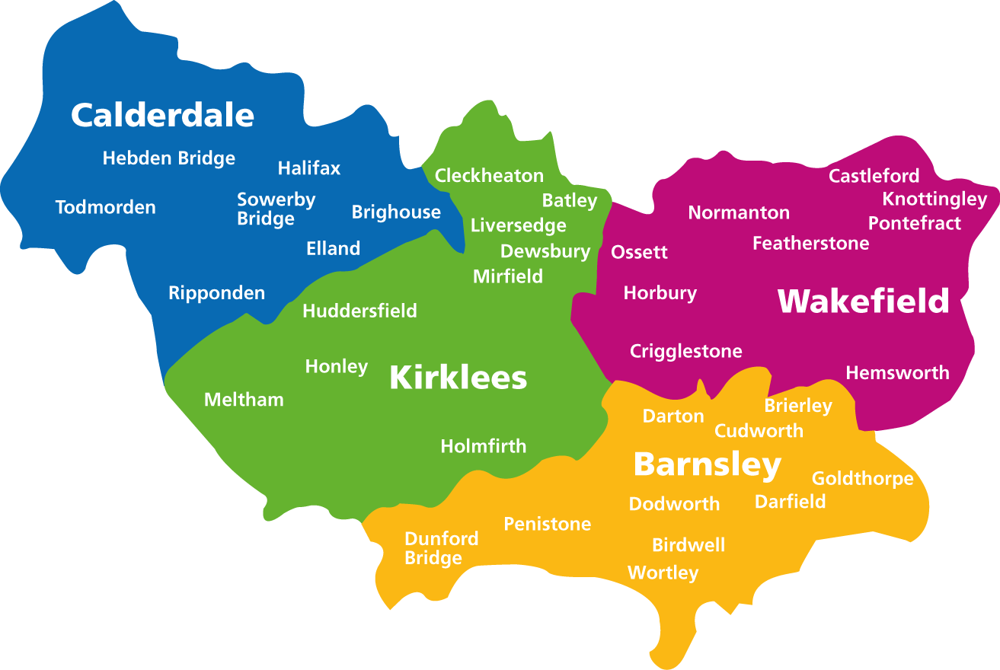





South West Yorkshire Partnership NHS Foundation Trust in numbers
We serve a population of
1.3 million people
470 BEDS ACROSS 5 INPATIENT SITES
Barnsley population is 244,600 (an increase by 13,400 since 2011).
Calderdale is 206,600 (increase by 2,800 since 2011).
Kirklees is 433,300 (increase by 10,800 since 2011).
Wakefield is 353,300 (an increase of 27,500).
The Trust also have services and staff in North Leeds, Sheffield, Doncaster, and Rotherham.
Each year we provide inpatient care for over 1800 people
Over 1500 community services
OVER 5000
STAFF EMPLOYED

Slide 5
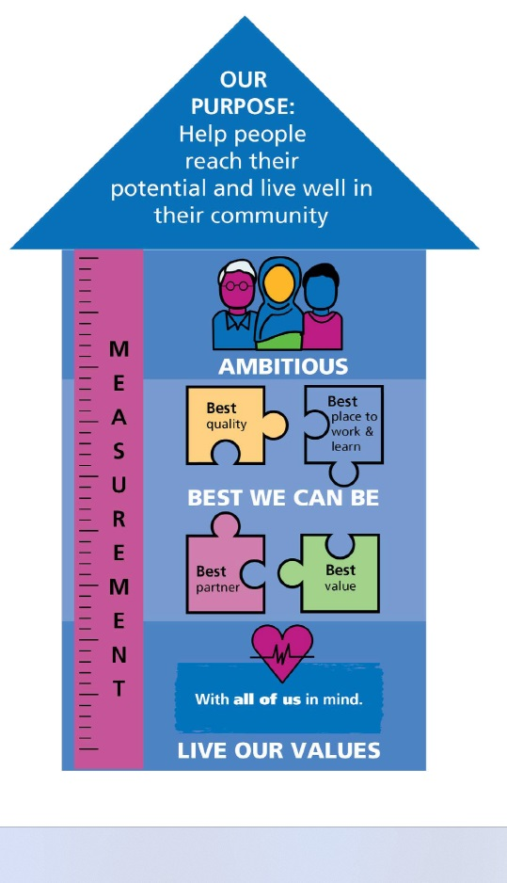
PCREF is part of our approach to delivering Trust
objectives and ambitions
Our Trust wide strategy refresh in 2024 saw reducing health inequalities identified as one of our key strategic ambitions: ‘Our leadership in reducing health inequalities through inclusive community connections and co-creation including in creativity and health’.
Our strategic aims:
We will live our values
We will be the best we can be
We will be ambitious
Best quality
April 2025 will see a launch of our refreshed Equality, Diversity and Inclusion strategy which has PCREF being identified as a key tool for delivery and measuring a meaningful and sustainable shift towards participation and collaboration.
This is a journey of working together to help us make the changes we need to improve access, outcomes and service user and carers experience. Helping EVERYONE reach their potential and live well in their community
Best value
LIVE OUR VALUES

Slide 6
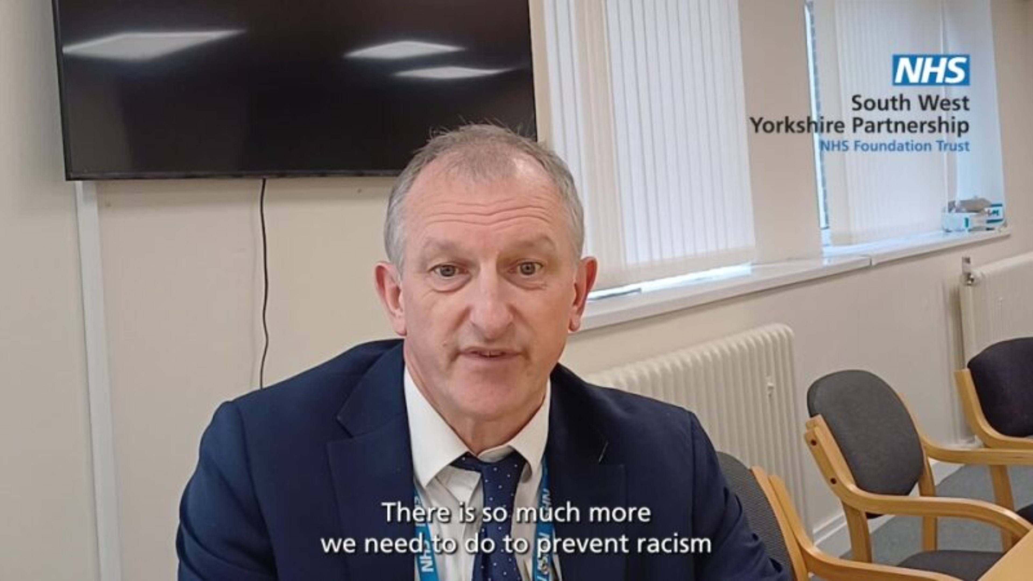

Slide 7
Why is PCREF important to our Trust?
Inequalities in health, housing, income and discrimination remain and there is need for improvement across each of our places. We know these inequalities put people at greater risk of ill health, mental ill health, or distress.
We also know that people who are mentally ill, those with a learning disability, and those who live in poverty face wider health consequences as a result.
Systemic racism and prejudice also affect our Black, Asian and minority ethnic communities.
Nationally we know that non White / British communities are more likely to have poorer access, experience and outcomes.
Approximately 15% of the communities SWYPFT serve are from minority ethnic communities.
In 24/25 approximately 10% of these referrals were received into SWYPFT Mental Health services, this is disproportionate to the population statistics and suggests those we serve from minority ethnic communities may not be experiencing the same access to services as White / British communities.

Slide 8
Why is PCREF important to our Trust?
Family, friends & carers
Workforce
Service Users
Communities
We recognise that people have different experiences depending on their race and background. The Trust wants to be more open and have conversations about race and inequalities and is working hard to come up with solutions to address racism and racial inequality.
We want to ensure
better access, experiences and outcomes for our racialised and marginalised communities.

Slide 9
A note on language and approach:
It’s important to acknowledge that current legislative terminology used to describe certain race and cultural identity do not always reflect people’s unique intersectional needs and lived experiences
Who do we mean when we say racialised and marginalised communities:
We use the terms ‘racialised communities’ which refers to ethnic, racial and cultural communities who are minoritised populations in England, have been racialised (Centre for Mental Health – Guide to race and ethnicity terminology), and/or marginalised that leads to social exclusion and often to unequal treatment and discrimination..
At SWYPFT our approach is to apply the PCREF core actions that are needed to address inequalities and improve care for communities faring worse across all of our mental health, learning disability and community health services.

Slide 10

Portia’s Story
Password: equality2022

Slide 11


Patient and Carer Race Equality Framework
Making anti-racism work for all Mental Health providers
Dr Jacqui Dyer, MBE
NHS England, National Mental Health Equalities Adviser Advancing Mental Health Equalities
April 2025

Slide 12

Background/history
NHS England (NHSE) published its first Advancing Mental Health Equalities Strategy in October 2020, laying out plans for addressing inequalities in access, experience and outcomes in mental health care.
The strategy summarises the core actions that are needed to address inequalities and improve care for communities faring worse than others in mental health services. It sets out three avenues to achieve this:
  Supporting local health systems to advance equalities
  Improving the quality and use of data to inform decision making,
and
  Creating a diverse and representative workforce which is equipped with the capabilities to achieve change
The Patient and Carer Race Equality Framework (PCREF) is a core part of the Advancing Mental Health Strategy and a key recommendation of the Independent Review of the Mental Health Act 2018, supported by the set up of the MHA African and Caribbean group to support with the aims of the independent review, focusing on the inequalities faced by racialised and culturally and ethnically diverse communities. NHSE agreed to take forward the PCREF soon after the review was published.
The delivery of the Strategy and the development of the PCREF is being overseen by the Advancing Mental Health Equalities Taskforce, and the PCREF Steering Group, established in February 2020, and chaired by Dr Jacqui Dyer, NHSE’s national Mental health Equalities Advisor.
2

Slide 13

Reclaiming the narrative
The fight against racial inequality and inequity in mental
health services is a very personal journey for me.
As a mental health service user and carer for the past few decades my experiential knowledge of mental health services is extensive and my commitment to this agenda is personal, political and professional.
I have been working with vulnerable and racialised groups and communities for many years and have seen the disastrous impact that systemic racism and injustice has had on so many peoples’ lives.
I have lost two brothers who throughout their lives struggled with long term mental health challenges and died at age 53 and 41. In 2022, I also lost my aunt, who died whilst in the care of mental health services.
“I am driven by the fight for a fairer system where people from racialised communities no longer have significantly worse experiences”.
In early 2019, I was appointed as the Mental Health Equalities Champion for England and am currently the Mental Health Equalities Advisor for NHS England.
To find out more about me and the significant work on advancing mental health equalities please refer to my profile on NHS England
3

Slide 14



Historical Context of racism in Mental Health Policies impacting systemic equities in care
Funding Disparities and their Impact on care
Barriers to Access
Systemic Racism
Historical policies have entrenched systemic inequities in mental health care, leading to persistent disparities in access and treatment for racialised
Financial inequities create significant barriers for racialised communities seeking mental health care, including limited availability of culturally competent providers and longer waiting times which results in a significant cost to NHS services. 2025 report by NHS RHO on The Cost of Racism
Insufficient funding for mental
health services in racialised
communities inadequate
leads treatment
to options health
communities, necessitating reforms to address these standing injustices.
urgent long-
resulting in
poorer
outcomes and experiences and
increased reliance interventions
on crisis
4

Slide 15



The Consequences of Dehumanisation in Mental Health services
Impact on Patient Trust
Cultural Misunderstandings
Long Term psychological impact
Dehumanisation fosters an environment of mistrust between patients and providers, leading to reluctance in seeking help and sharing critical information about mental health conditions right
Lack of cultural competency among mental health professionals results in misinterpretation of systems and needs, exacerbating the challenges faced by racialized communities in receiving appropriate culturally competent care
The ongoing demonisation of individuals in mental health services
contributes to chronic stress and worsen mental health outcomes and experiences, perpetuating cycles of disadvantage and limiting recovery opportunities
5

Slide 16







Recent Events Highlighting Racial Disparities
NHSE PCREF 2023
Mental Health Act Bill 2024
Impact of Societal Unrest
Urgent need for Reform
The persistent racial disparities in mental health outcomes the critical need
Societal upheavals, such
have
as race
highlighted
riots
the
Draft Equality (Race and Disability) Bill 2024
mental
health implications
of
Darzi Report 2024
discrimination exacerbating
for targeted measures to
legislative
ensure
existing health disparities among minority
equitable access to mental
health care for all
communities right and then
6

Slide 17
Evolution of the PCREF
18 Pilot Trusts joined to support NHSE
The Crisp commission report and NHSE FYFV MH
NHS England agree to take forward PCREF
CQC and EHRC agreed to work with NHS England
Three sites join
Four Pilot sites join
Six Early Adopter sites join
Official launch
of the PCREF
Five more sites join!
2015 – 2016
2018
2019
2020 – 2021
2021 - 2022
2022
2023
2024
2025
Independent review of the MHA – recommended the PCREF, culturally appropriate advocacy, and advance choice documents. The African and Caribbean group (MHARAC) was established to support the aims of the independent review.
NHS England publishes Advancing Mental Health Equalities strategy
Launch of draft PCREF
PCREF included in the NHS Standards Contract
Draft Mental Health Bill
PCREF local engagement via Pilot sites
NHSE Regions set up PCREF Network Groups
7

Slide 18
What makes the PCREF stand out?
Support from Association of Directors of Adult Social Services in England
NHS
England’s Culture of care standards for inpatient services
CQC mental health inspection processes
Support from other statutory and voluntary and community sectors
NHS
Standards Contract 2024-2025
NHS England’s Core 20Plus5
Equality Human Rights Commission – Public Sector Equality Duty (Equality Act 2010)
NHS England’s Health Inequalities legal statement 2023
NHS England’s Equality Delivery System 2022
Triangle of Care
8

Slide 19
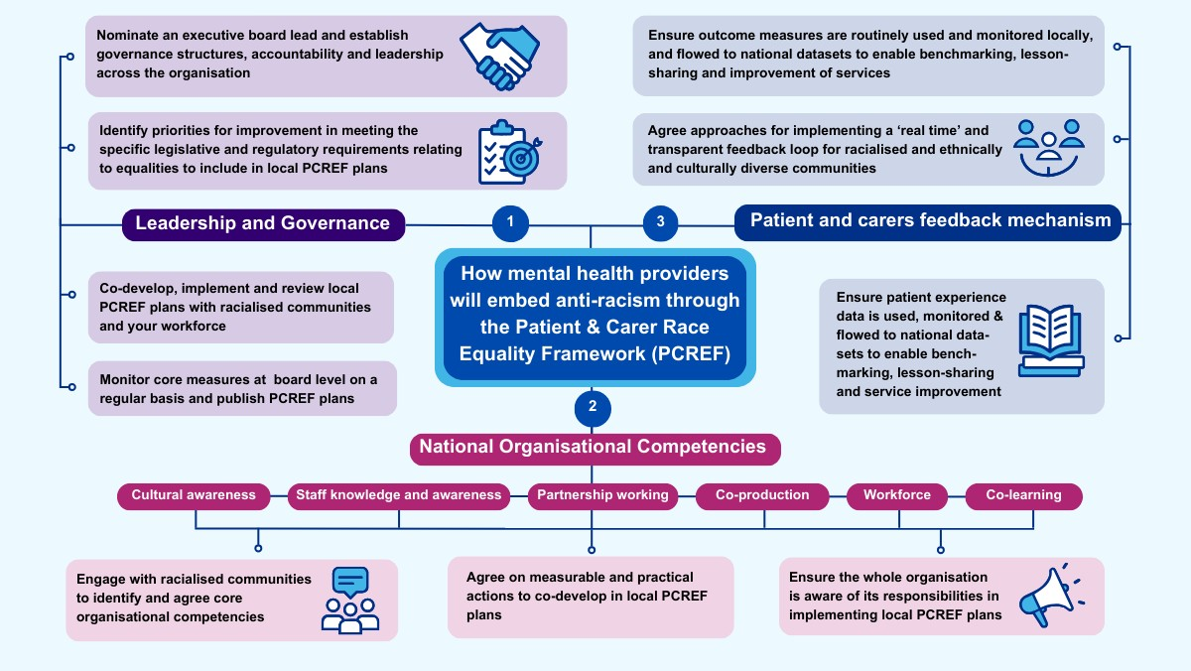
9

Slide 20
The importance of PCREF influencing the reforms
PCREF aligns closely with the Mental Health Act Reforms and supported by the Darzi Review’s vision for NHS
transformation, particularly its Three Big Shifts, which guide the NHS 10-Year Plan:
From Quality of Care to Quality of Life
From a Healthcare System to a Health and Wellbeing System
From Centralized to Localized Care
By embedding PCREF principles in NHS governance, performance metrics, workforce development, and patient
feedback mechanisms, we can:
Address systemic racism in mental health services.
Improve patient outcomes for racially minoritized groups.
Drive NHS performance through transparency, accountability, and inclusion.
Strengthen the role of NHS leadership in reducing racial inequities.
10

Slide 21

Annex
Resources
11

Slide 22
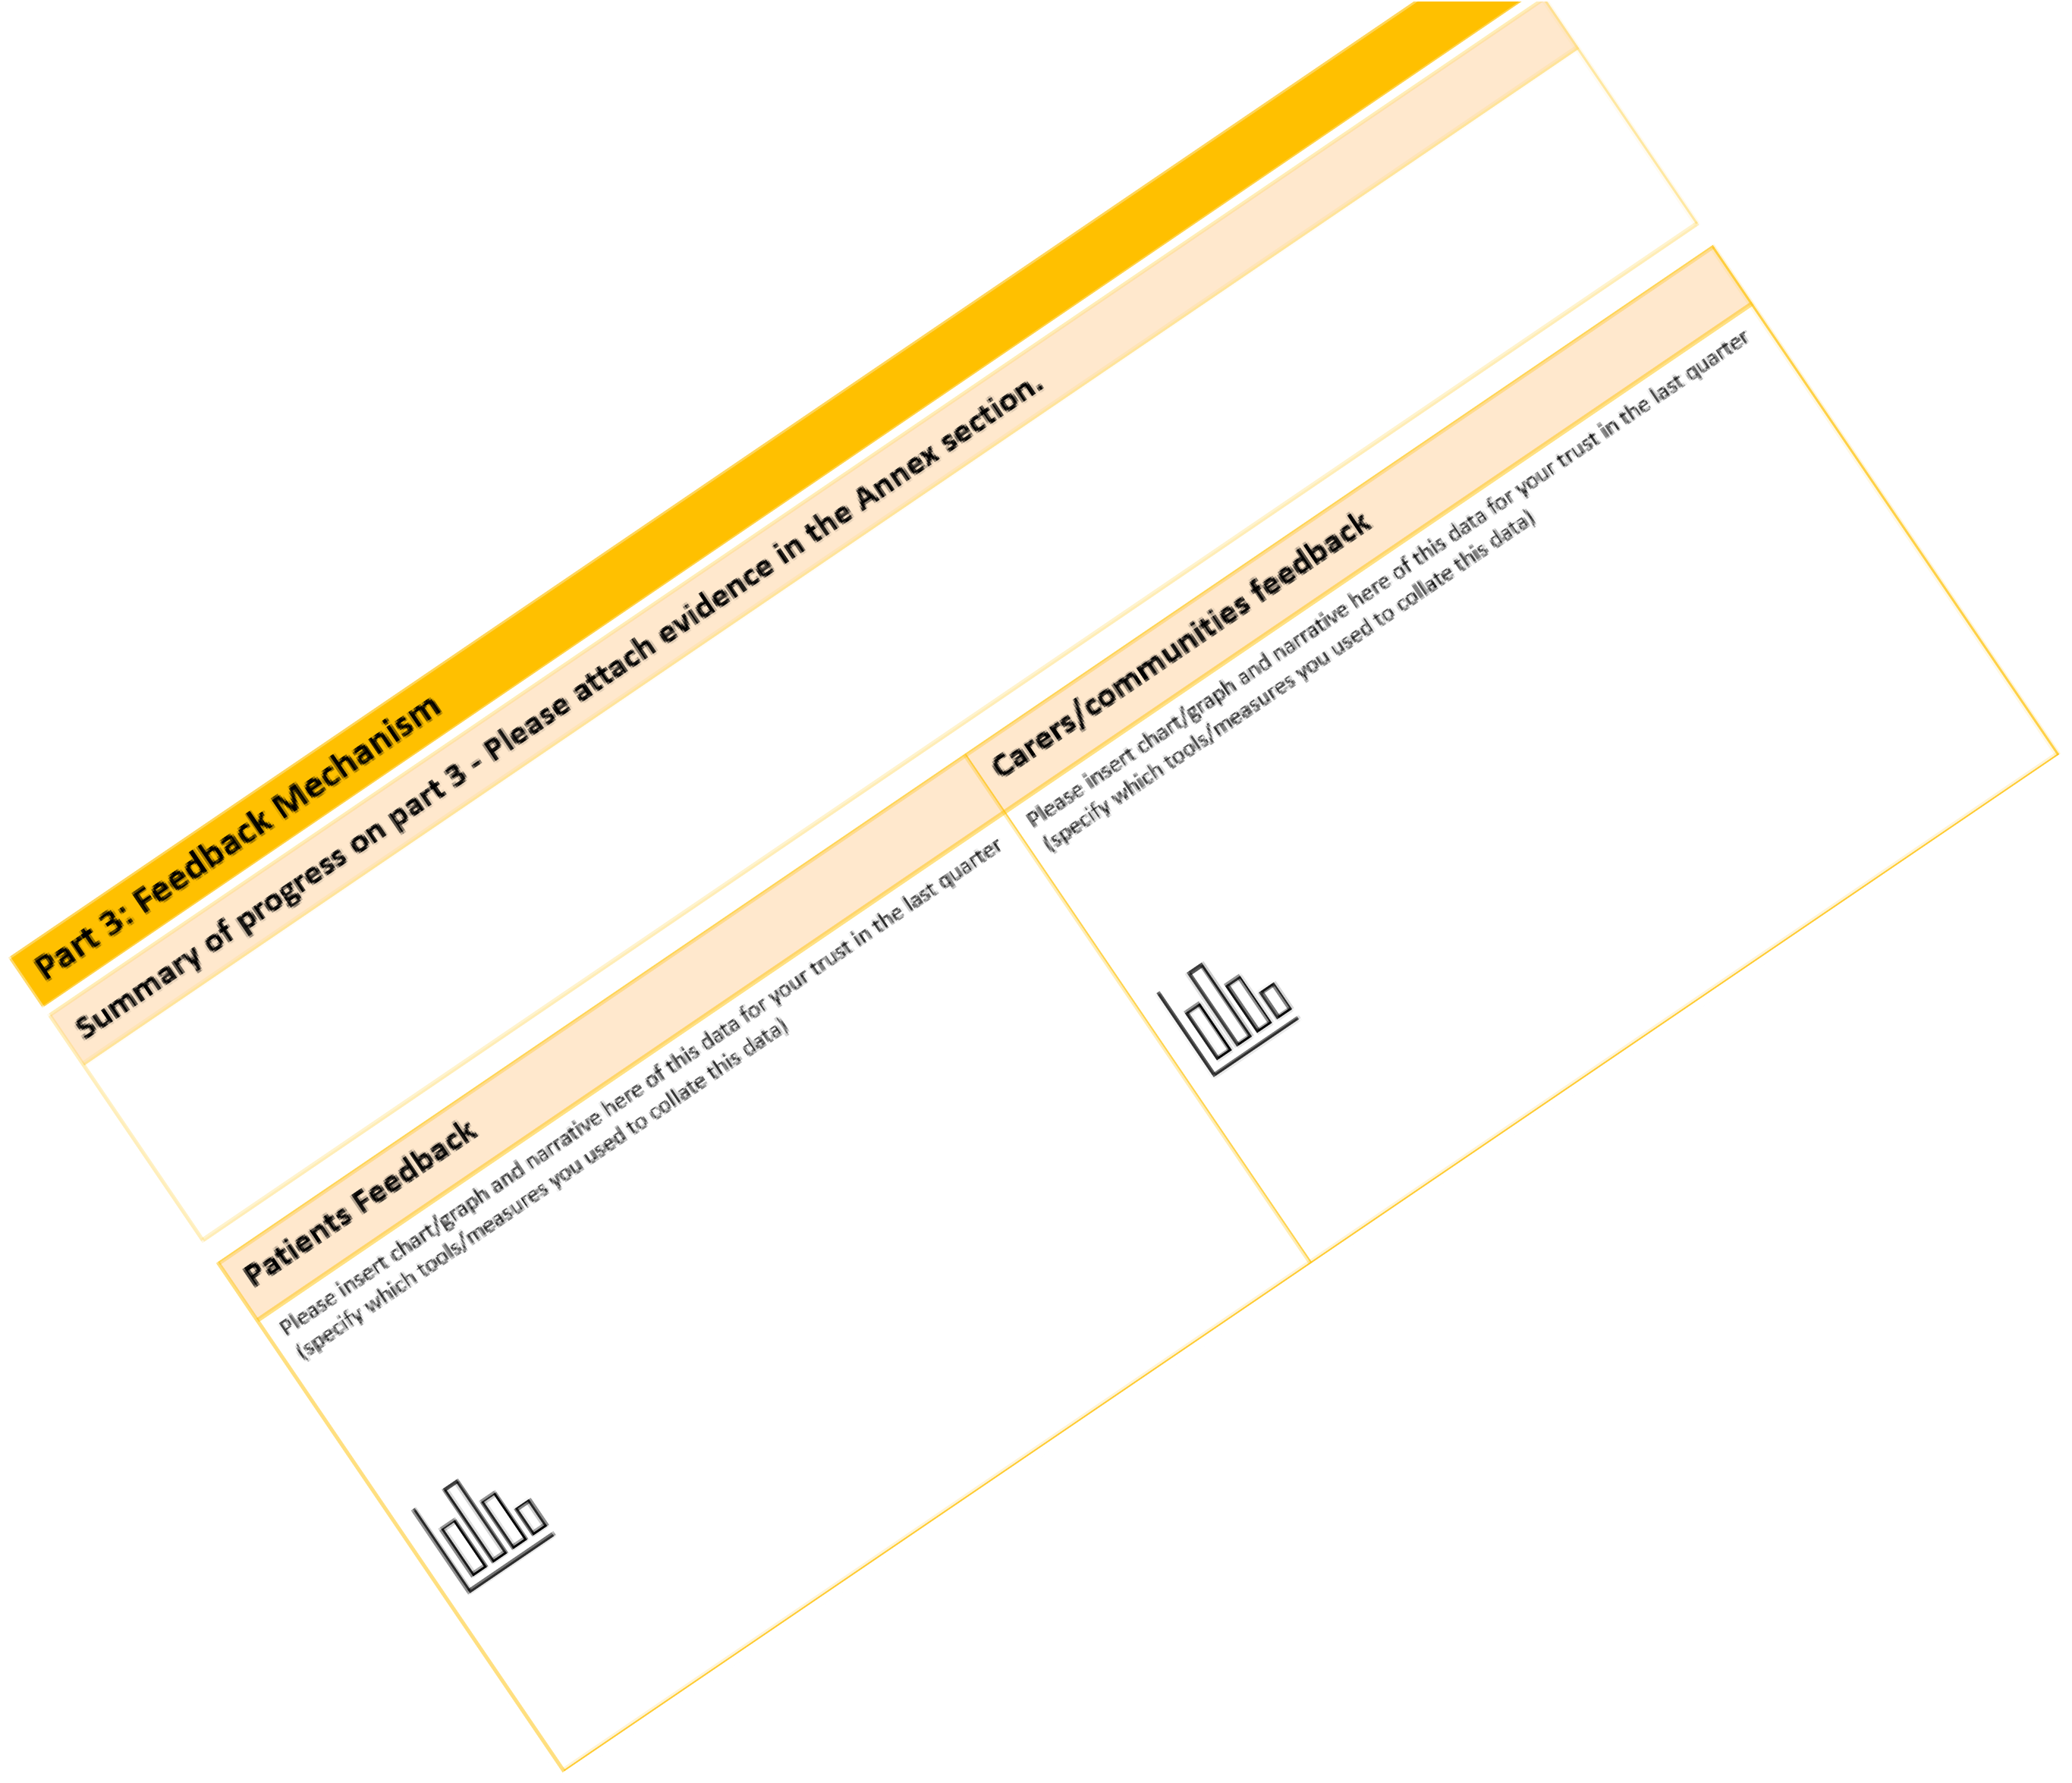
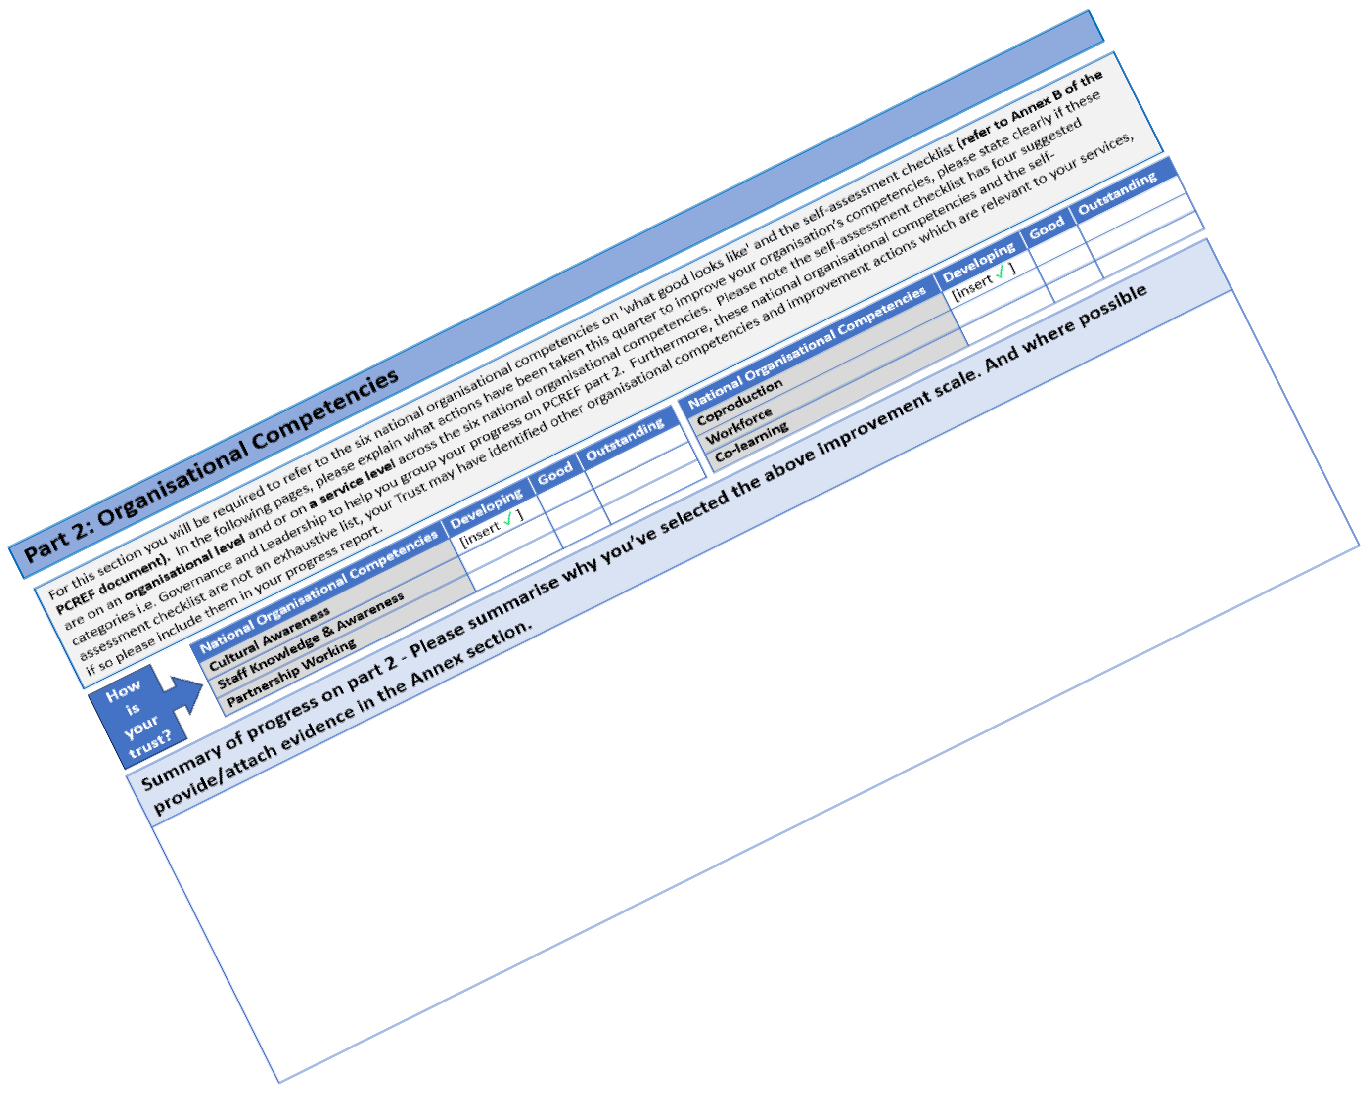

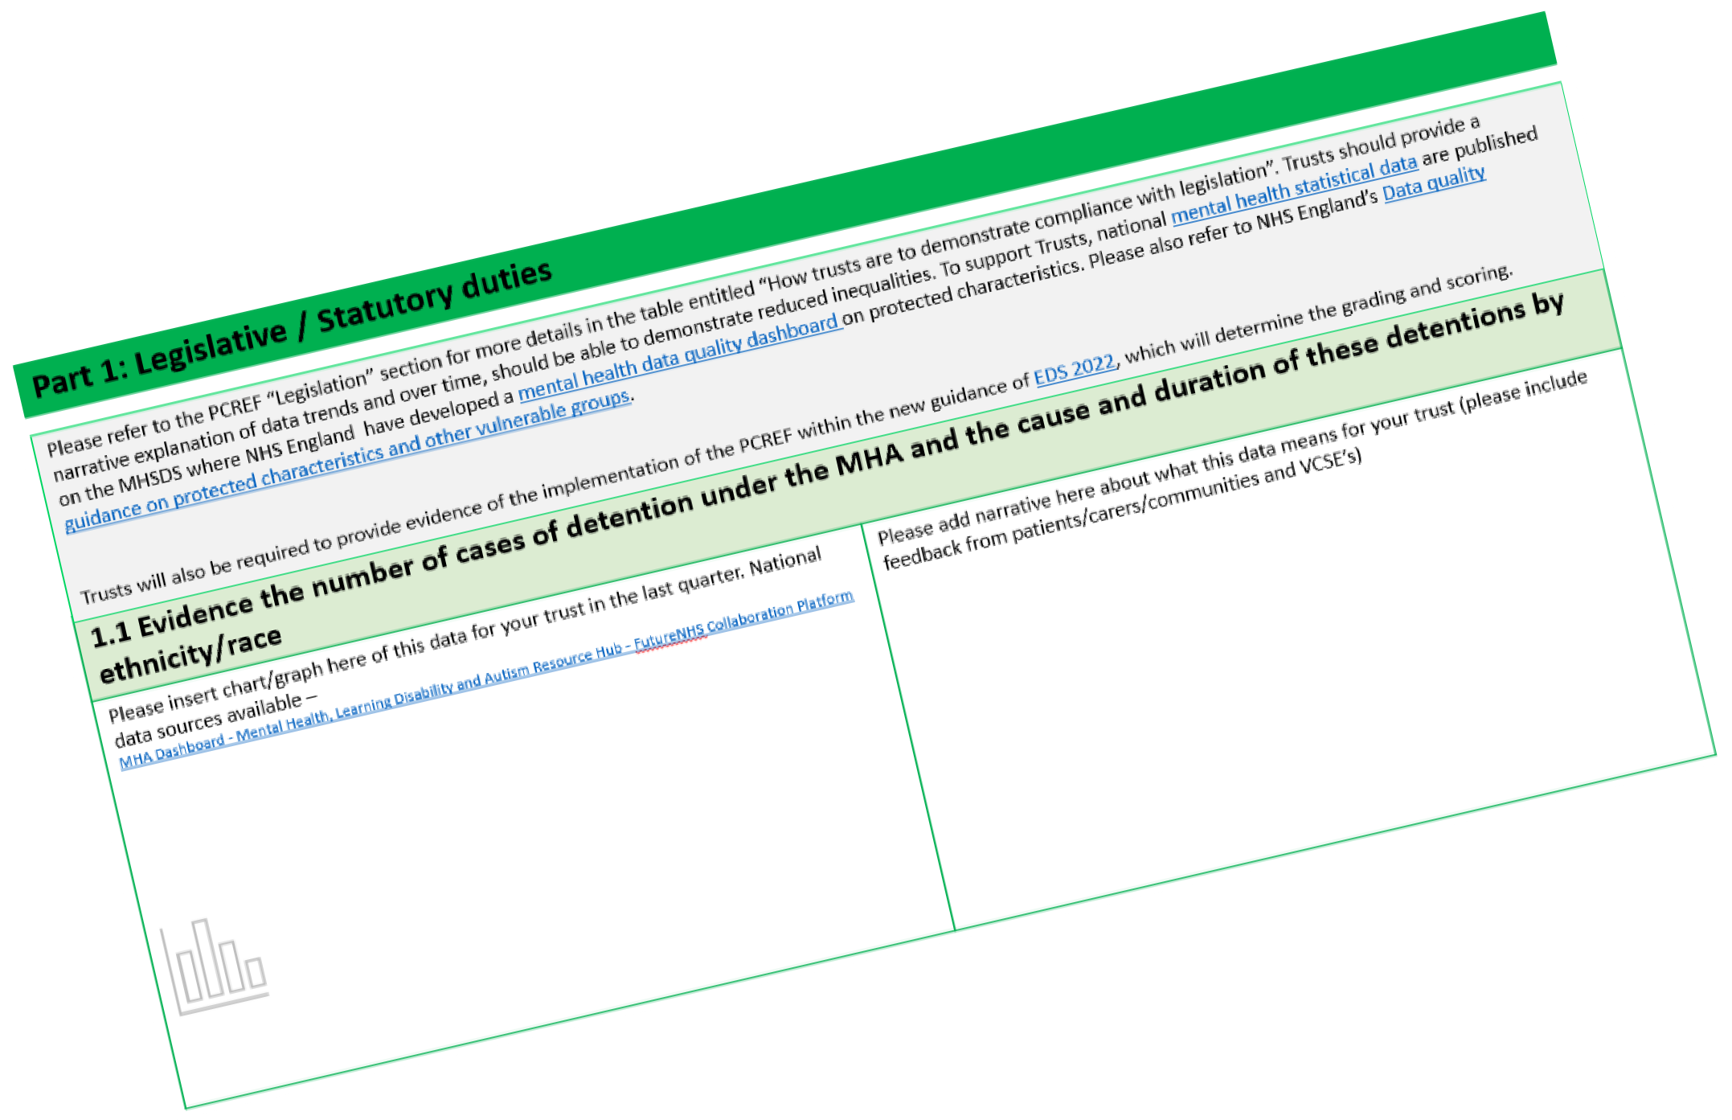

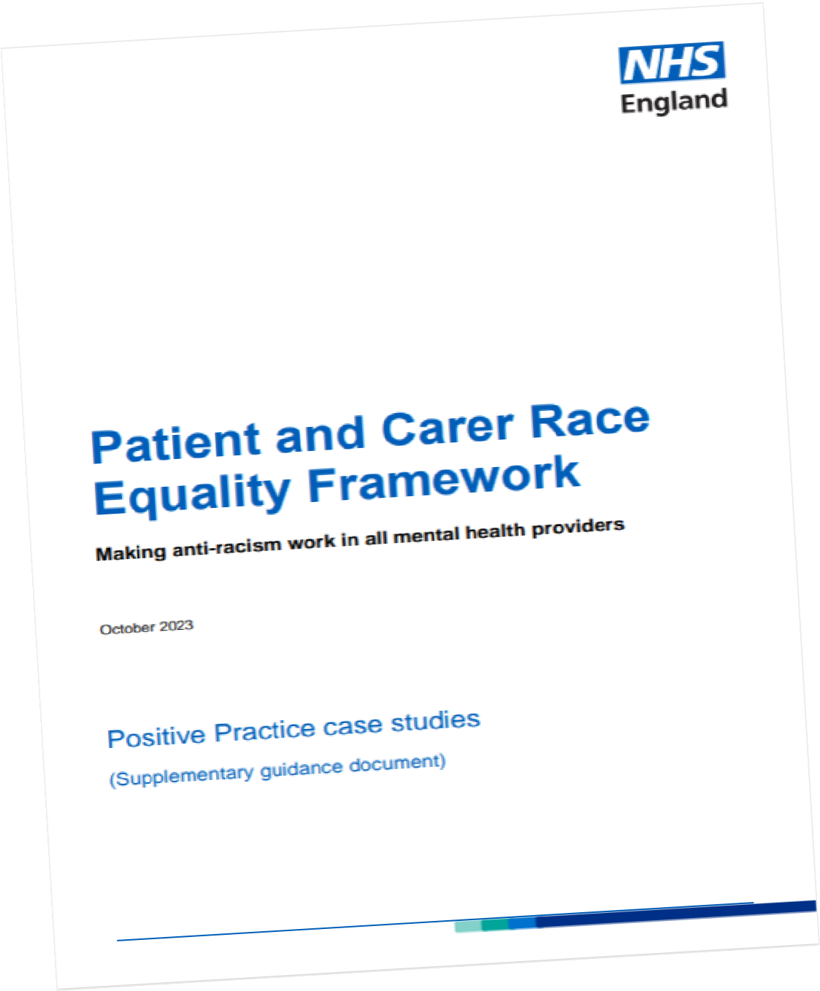


Get yourself familiar
www.england.nhs.uk/pcref
NHS Future Collaboration site
PCREF report
12

Slide 23










Patient and Carer Race Equality Framework
NHS England (NHSE) published its first Advancing Mental Health Equalities Strategy in October 2020, laying out plans for addressing inequalities in access, experience and outcomes in mental health care.
The PCREF is a core part of the Advancing Mental Health Equalities strategy. It was also a key recommendation of the Independent Review of the Mental Health Act 2018 that NHS England (NHSE) agreed to take forward.
Now have 18 Mental Health Trusts helping NHS England to develop the PCREF
South London & Maudsley Trust
North East London Foundation Trust
Sheffield Health & Social Care Foundation Trust
Nottinghamshire Healthcare Foundation Trust
Black Country Foundation Trust
Oxleas Foundation Trust
Essex Partnership University Trust
Southwest & St George’s Trust
Leeds & York Partnership Foundation Trust
East London Foundation Trust
Gloucestershire Health & Care Foundation Trust
Greater Manchester Foundation Trust
Oxford Health Foundation Trust
St Andrew’s Healthcare Trust
South West Yorkshire Partnership Trust
Birmingham and Solihull Trust
Pennine Care Foundation Trust
Lincolnshire Partnership Foundation Trust

Slide 24


Thank you
Email: england.mentalhealthpmo@nhs.net
Learn more about NHS England recently published Patient and Carer Race Equality Framework: https://www.england.nhs.uk/pcref
And for additional information on the PCREF – including a positive practice guidance, can be found here: NHS Future Collaboration Platform
Learn more about the advancing mental health
equalities programme here.
14

Slide 25
Patient and Carer Race Equality Framework
Mandatory Anti-Racism Framework
- Our Journey towards equity in mental health
Zoë Reed
Director Organisation and Community; Freedom to Speak Up Guardian
South London and Maudsley NHS FT
PCREF Joint Strategic Lead
Co-Chair Joint Anti-Racism Steering Group
with Dr Jacqui Dyer MBE
South West Yorkshire
Partnership NHS FT
3rd April 2025

Slide 26


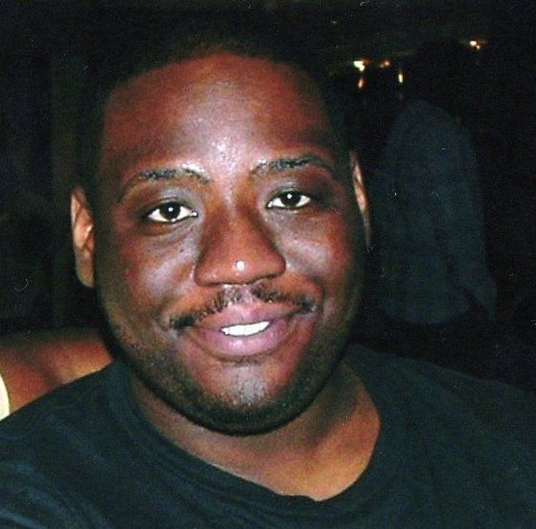
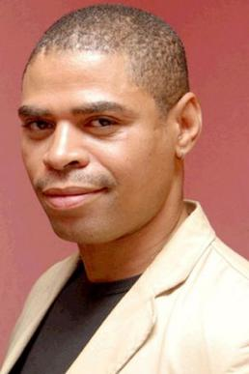


PCREF at South London and Maudsley - context
The issue of inequity had been of great concern to the Trust and the local community for many years; compounded by the tragic deaths of Sean Rigg and Olaseni Lewis
We are involved in lots of research and have leading experts in the field amongst our staff - but inequities persist
We were involved in the Review of the Mental Health Act and were aware of the recommendations of the African and Caribbean Sub-Group
We had been developing a way of working with local communities to enable us to jointly pilot community proposals for improvements with services
www.slam.nhs.uk/PCREF
3

Slide 27








Why PCREF is important for our Trust and the reasons behind our Approach
The Trust has 36.7k patients -
9.2k are Black and Mixed Black
[as at May 2024]
The PCREF is a partnership approach – so we needed to be clear who we are building partnerships with
Black African, Black Caribbean and Mixed Black people are more likely to have poorer access, experience and outcomes according to our data
By building on our existing relationships with local Black communities we have been building our PCREF Partnership
So, a quarter of our patients are potentially less likely to receive a quality service – this is unacceptable
Racism in a Quality issue
Wanted to take a systematic iterative approach to the conditions holding racism in place and evaluate effectiveness of initiatives as we go
www.slam.nhs.uk/PCREF
4

Slide 28
Racial Inequities – some examples
The Trust admitted 145 patients on section in May 2024 out of 242 admissions - ie 60% of all Trust admissions were on section.
The inequity is that 48% Black patients / 27% White patients
The data for 23/24 above shows the Restraint Proportion by ethnicity. There was only a couple of months – May 2023 & January 2024 – when there was close to equity between Black and White patients; in all the other months, the inequity is clear

Slide 29



Our PCREF approach
Our logo now!
Initial logo
Partnership between the Trust and two Black-led Host Organisations supporting local IAGs*
Triple leadership** approach involved in all decision making
Mainstreaming PCREF into the Trust’s systems for planning and monitoring
October 2020:
PCREF launched before the Trust’s strategy .. Influenced strategy and aligned in 2023
The Trust’s Strategy commits to embedding PCREF at scale and leading anti-racism in mental health by 2026
Triple Leadership Teams have developed Change Ideas to test embedding
*Independent Advisory Groups
** Service User/Carer Rep, Community IAG Rep, Staff Senior Rep
www.slam.nhs.uk/PCREF
6
Notes:
PCREF is a partnership between the Trust and two Black-led Host Organisations (Lambeth Black Thrive and Croydon BME Forum)
We have a triple leadership approach, comprising a Black service user / carer, Black community member and Trust staff rep involved in all decision making
We begun mainstreaming PCREF into the Trust’s strategic, operational performance management systems to ensure accountability for delivery
PCREF launched in Oct 2020 as an initial 2-year programme – before the Trust Aiming High; Changing Lives was developed
The Trust’s strategy includes a commitment to embedding PCREF at scale and to be leading anti-racism in MH by 2026 (part of the Culture of Trust ambition)
We have aligned the PCREF programme timing with the Strategy – so extended until 2026
This is helpful as it recognizes (as we all know) that our work is long term and complex ​

Slide 30
How did we get to where we have got?
A focus on process: the how - not the what
Partnership Development with local Black-led Community Organisations
Began with developing logos, branding and images together – Design work led by the Community Organisations [not NHS style!]

Slide 31




Service Users and their Carers
Staff
Community

Slide 32


Slide 33
South London and Maudsley
PCREF Partnership Governance
Our model considered an exemplar and
used in launch material for PCREF

Slide 34

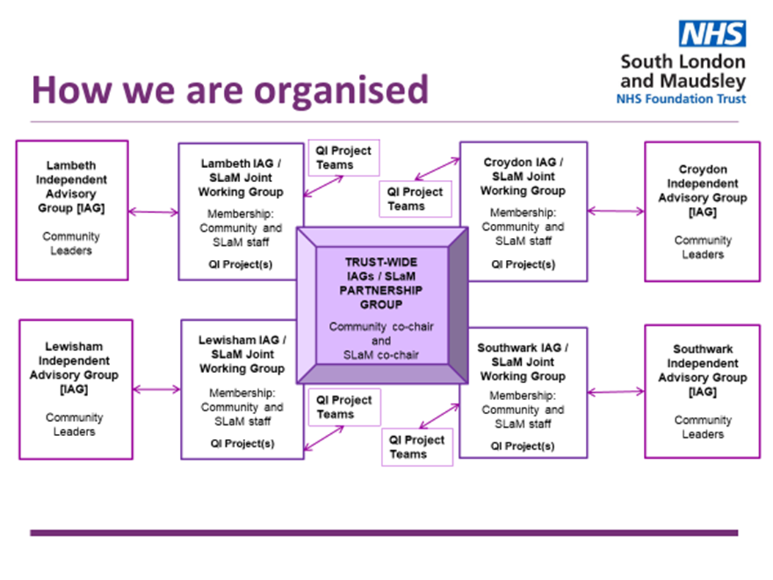
Governance – built on pre 2020 structures

Slide 35
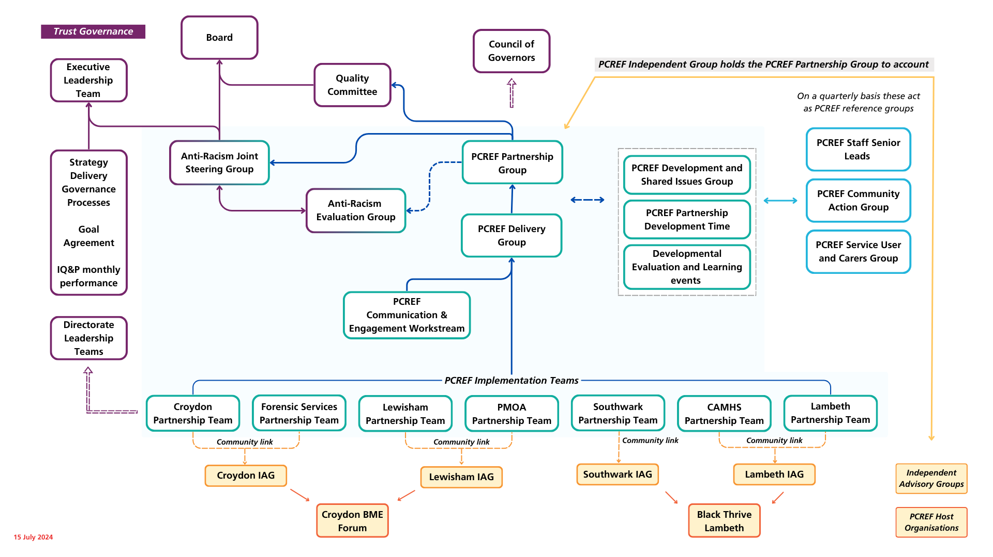
Governance - connecting Community and Trust: Triple Leadership throughout green coloured area

Slide 36
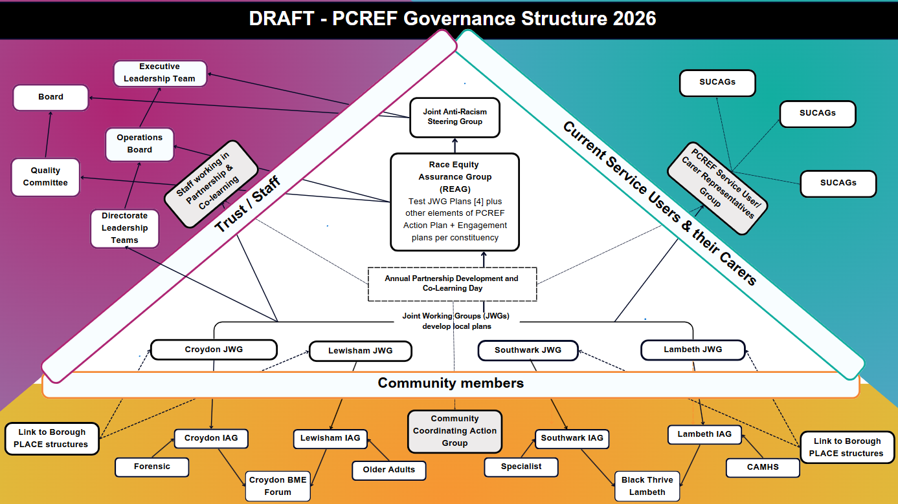

Slide 37
Journey so far
[Roadmaps to embedding PCREF as
Standard Operating Procedure in Annex]

Slide 38
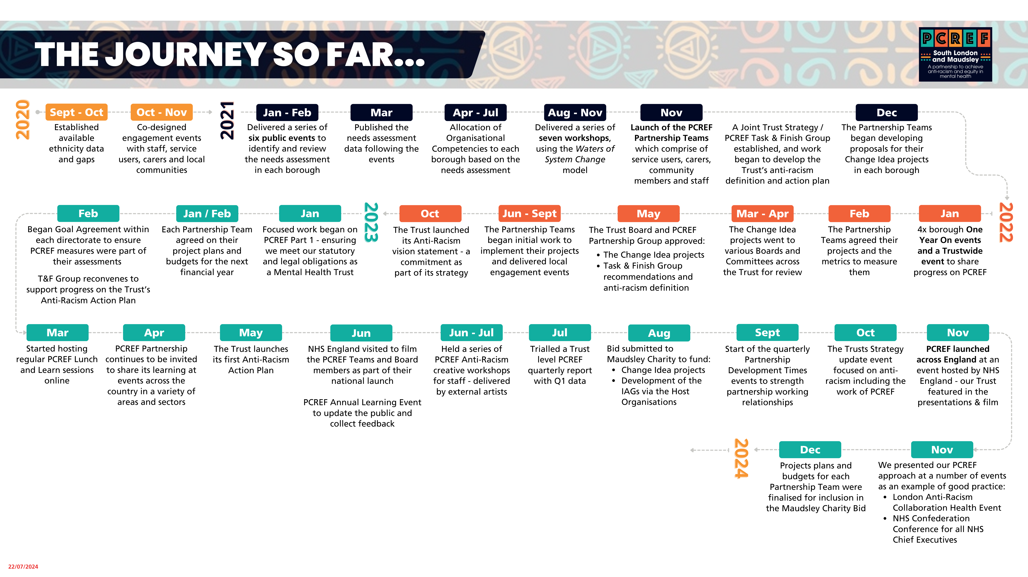
Task and Finish Group [T&F Group] now named Joint Anti-Racism Steering Group
Many developments and much work in 2024 – just haven’t found the time yet to write it down!

Slide 39
Part 2: National Organisational Competencies [NOCs] - change ideas development process
This work was undertaken in 2021/2022

Slide 40
Summary of Stages: Borough-based NOC development
Stage 3 [Sept-Oct 2021] Stage 4 [Nov] Stage 5 [Dec]
Separately Together Together
Workforce NOC development held in abeyance pending Trust anti-racism plan
4 Staff Problem Solving Groups [1 per Borough]
Completed analysis using WoSC
Completed mapping of existing projects
Mapping NOCs to PCREF metrics
Initial thoughts on change ideas to try
Each Group to present analysis to meeting of Service Directors
Early November
18 November PCREF Partnership event
Community
SU/Carers
Staff Groups [4]
to share thinking and analysis
Start building PCREF Partnership Teams
Borough-based
PCREF Partnership Teams
preparation of joint presentations on findings and proposed change ideas for public events [in January]
Service User and Carers Reps Group
Developed confidence and expertise in the NOCs
Undertaken learning on any aspects they wish
Built network of Borough based service users/carers
Identified activist volunteers to join Workstreams
Act as Reference Group for PG
Nominated reps to LOCs* Task and Finish Group
PCREF Partnership Teams presentations to public meetings
Community Action Group
Develop confidence and expertise in the NOCs
Undertake learning on any aspects they wish
Build network of Borough based IAG members
Identify activist volunteers to join Workstreams
Act as Reference Group for PG
Nominate reps to LOCs* Task and Finish Group
PCREF Pilot Sites Engagement event with NHSE
7 December
* LOC = Local Organisational Competency = Anti-Racism

Slide 41
Final list different from initial one –evolved and changed
as partnership working matured and all voices strengthen

Slide 42
National Organisational Competencies - summary
Cultural Awareness
Recognising and understanding the diverse cultural backgrounds of the communities a Trust serves
Partnership Working
Services work more closely with racialised and ethnically and culturally diverse communities, leaders and other organisations beyond the NHS, to support wellness and embed anti-oppressive partnership working
Staff Knowledge & Awareness
Recognising and understanding the racialised experiences of the communities a Trust serves and overcoming biases and prejudices by acting upon them
Two-way process that strengthens collaborative knowledge sharing beyond co-production principles and focuses on how Trusts can raise awareness of early intervention support amongst racialised and ethnically and culturally diverse communities
Ensuring ethnically, and culturally diverse patients and carers are treated as equal partners in decision making on their care and treatment plans.
Workforce
Co-production
A culturally competent and diverse workforce that has a positive impact on patient and carers from racialised and ethnically and culturally diverse communities
Co-learning
Our Workforce
The Way we do things here

Slide 43
Group Agreement – Individual and Collective Accountability

Slide 44

From our beginnings November 2021
Lambeth Town Hall

Slide 45
Our Group Agreement
Co-developed through an extensive process involving working in separate constituencies and in together spaces
Respect and value each other
Working in partnership with understanding
We are learning together
Empower the voices of all Black and Mixed Black people
Collective accountability for an effective PCREF delivery
Read out, together with the Purpose of the Meeting, at the beginning of all our PCREF Governance meetings

Slide 46
Overview
Our PCREF Governance model has been designed for us to:
Work collectively, strategically and systematically to make change
Bring into effect true Partnership Working
Bring together individuals who have a shared vision and purpose
The Triple Leadership model ensures all 3 perspectives are heard equally
Each Constituency has a specific separate responsibility for action
Together we collectively provide accountability, appropriate challenge and assurance

Slide 47
Areas of individual and collective responsibility
[from our Principles document]
Service User and Carer Representatives
Community / IAG Representatives
Staff Representatives
Will the proposed changes improve service users and their carers experiences?
Is there a sense of genuine co-production between them and clinicians / the Trust?
What would a co-learning approach look like for them in receiving clinical services?
What do local people and local Black-led VSCEs understand about PCREF?
How would they like to see it developed with and for the community?
Is the information they receive enabling them to work in Partnership with the Trust?
Do staff feel they have the Knowledge and Awareness and Cultural Awareness to eliminate racial inequity in services?
Are the proposed changes feasible and scalable?
Is PCREF visible at all levels and services within the Trust?

Slide 48
Developing our Vision

Slide 49
PCREF as a Standard Operating Procedure – 2026/27 and beyond: Developing a Vision
NHSE PCREF Dashboard [national, regional ICS and local] up and running so all our quarterly data can be compared with other Trusts; continual improvement in metrics [PCREF Part 1, 2, 3]
The National Organisational Competencies are embedded as the way we do things around here, building on the learning from the 9 Pilot Change Ideas tested and evaluated in 2025 [PCREF Part 2]
The Feedback App/Mechanism is being used by patients from racialised communities to provide real time feedback on their experience to providers; Pair DIALOG scoring undertaken by majority of patients with their clinicians and results used to identify and eliminate inequity [PCREF Part 3]
IAGs along with communities and community organisations respond to the PCREF Self-Assessment [i.e., feedback on the mandatory PCREF Action Plan] – starting in April 2025
Based on information from Part 1 and Part 3, Services routinely engage with current patients and their carers from racialised communities together with IAGs [interested citizens and appropriate VCSs] to co-create improvement ideas
The Trust is leading anti-racism in mental health across all its activities - taking a learning approach to all its delivery using the Toolkit to name racism and eliminate it wherever it is found

Slide 51
Naming Racism – Tackling Causes

Slide 52

Anti-Racism Vision Statement launched October 2022
The Trust, as a mental health service provider, aims to apply anti-racism approaches to remove the conditions that hold systemic racism in place. These are conditions where bias and prejudice are built into systems, policies, processes, resource flows, practices, relationships and connections, power dynamics and mental models. We will:
ensure our organisational leadership and culture will embody anti-racism
be an anti-racism employer and workplace
collaborate with the mental health sector and our partners to promote, and evaluate, our anti-racism approach
incorporate an anti-racism agenda into our organisational development; our training, education and research work and our innovations
integrate anti-racism into our brand, media campaigns and communications
nurture an environment of listening, learning and unlearning racism
embed anti-racism in all that we do to ensure better access, outcomes and experience for our service users, carers and the communities we serve

Slide 53
Anti-Racism Plan agreed May 2023
- Areas for Focused Action
Five main workstreams
  Services – PCREF
  Workforce
  Communications and Engagement
  Research
  Working with Police
Emerging work areas through the Joint Anti-Racism Steering Group
  Procurement
  Policies and Practices including Equality Impact Assessments
  Professional and Managerial action driving anti-racism in services and workforce
  Professional and Quality/Safety Standards

Slide 54
Governance and Accountability
The Trust is using several mechanisms to ensure transparency and accountability on its Anti-Racism Plan progress. These include:
Ongoing check and challenge from the Joint Anti-Racism Steering Group [JARSG] throughout the year. Jointly chaired by Dr Jacqui Dyer [Community] and Zoë Reed [Trust] with equal representation from PCREF Service User/Carer reps and IAGs [Independent Advisory Group] Community reps as well as Staff reps and Trust Board/Senior Leadership. Staff from all key areas of the Anti-Racism Plan attend to present their progress.
The Trust Board reviews progress on an annual basis. Quality Committee 6 monthly.
The bi-annual public Strategy Progress events – all strategy events update on progress.
The PCREF Developmental Evaluation Workstream - with triple leadership [i.e. service user/carer, community and staff reps] - is evaluating progress on the implementation.
As part of our business-as-usual arrangements for monitoring strategic delivery, progress is reviewed by the Executive Leadership Team on a monthly basis via the Strategy Deployment Room (SDR) meetings.

Slide 55
Part 2: Evaluation Approach
- Results must be respected by all three partner constituencies
Initial discussions centred on how to identify an evaluation methodology
that recognised the complexities of working in partnership and that could
accommodate ideas adapting and changing, and that everyone could get
behind
  Community [Host Organisation] proposed Developmental Evaluation
  Trust proposed PROCTOR Framework
This has resulted in our quarterly evaluation system looking at qualitative
as well as quantitative data

Slide 56
Developmental Evaluation And Learning [DEAL]
Cycle 1
Cycle 2
Cycle 3
Cycle 4
Final outcome
Patient Outcomes
DIALOG
PEDIC
Service Outcomes
LOS
Treatment adherence
Implementation
Measures
Adoption
Sustainability
f/y 24/25 Q2
Scalability/
Affordability
Assessment
Business Planning 26/27 start Upscale
Embed into practice
Health Economic Assessment
Service use
Access
Seclusion Restraint
Use of detention
Diagnosis
and
Medication
tbc

Slide 57
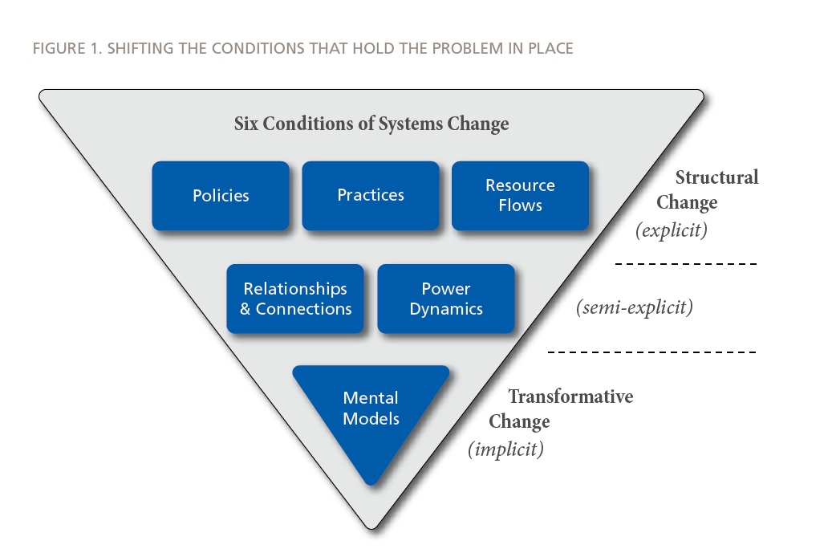
TOOLS TO TACKLE INEQUITY: Water of Systems Change [WoSC]:
Shifting the Conditions holding the problem of racial disparity in place Action at Trust wide and local Team level
Each Anti-Racism Plan component undertakes this analysis;
Each Team given Toolkit to do local work on an identified problem of inequity
Team level and Trust level Change Ideas with quarterly evaluation can then evidence that the Trust is leading anti-racism in mental health as everyone is taking action

Slide 58
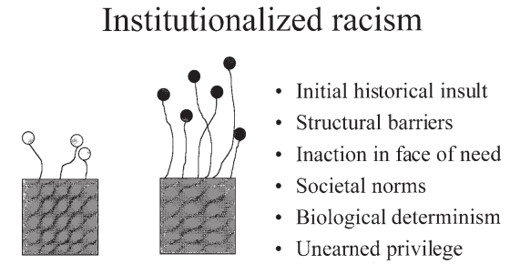
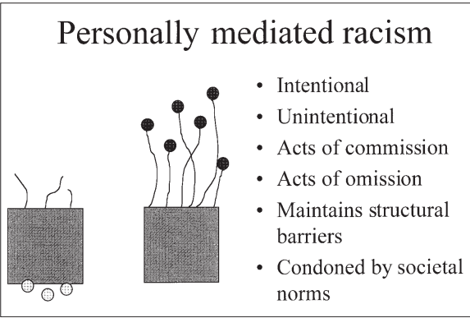
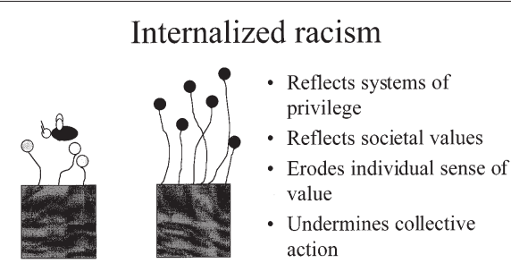
3 Levels of Racism – A theoretical Framework; [blended with WoSC in Toolkit to complete the analysis]
Nathan Stanley, Black Thrive ppt - summary of Jones, 2000
1)
Material Conditions
Access to Power
Institutionalised Racism
2)
Personally Mediated Racism
Prejudice
Discrimination
Acceptance of negative messages about own abilities
3)
Internalised Racism
Notes:
Theory Reference: Jones CP. Levels of racism: a theoretic framework and a gardener's tale. Am J Public Health. 2000 Aug;90(8):1212-5. doi: 10.2105/ajph.90.8.1212. PMID: 10936998; PMCID: PMC1446334.

Slide 59
Anti-Racism Developmental Evaluation Toolkit:
2 documents (i) Context (ii) Guidance
Provides a Tool to implement these concepts
Documents developed by Evaluation Lead from Global Black Thrive (local Black-led VCSE) working in partnership with PCREF Joint Strategic Leads.
Documents being tested and improved through working with staff and teams across the Trust.

Slide 60
A few final thoughts

Slide 61
Implementing PCREF –some key aspects [1/3]
Genuine Partnership working
  Genuine partnership with local Black-led VCSE; community members and service users and their carers must be evidenced through governance
  Essential to recognise the impact of power imbalance across all dimensions
Clarity on what PCREF is and what it isn’t
  Driven by our data – initial focus on eliminating racial inequity for Black Citizens
  PCREF is not about community engagement per se – it is about partnership working in order to change Trust services to eliminate inequity
  PCREF is not about general improvement – it is about eliminating racial disparity in access, experience and outcomes. A Quality and Safety issue.
Getting the Governance right – and keep refining
  Everything in partnership – co-design and co-delivery
  Triple leadership of all governance arrangements and in everything we do
  Strengthening the Independent Accountability is crucial to earning trust

Slide 62
Implementing PCREF –some key aspects [2/3]
Mainstreaming from the outset
  Agree metrics and build into routine performance monitoring and Board reporting
  Align where we can but remember the PCREF approach is different - so initially guard against being absorbed into other programmes and losing focus and impetus - until fully embedded and the PCREF Approach becomes the Standard Operating Procedure of the Trust
Shifting the Conditions that are holding the Problem in Place.
  Co-Design the Programme to tackle policies; practices; resource flows; relationships & connections; power dynamics; mental models
  Ensure change ideas will eventually impact all staff in every service
  Documenting the Policy and Practice improvements as we go
Central to the Trust’s Strategy 2021-2026
  Quadruple constituency equal membership of Joint Anti-Racism Steering Group defined anti-racism and building trust and confidence of racialised communities in the organisation; provides check and challenge of implementation and ensuring there is evaluation of the interventions and activities in the name of anti-racism to provide evidence that they are delivering the Strategy Commitments
      to take PCREF to scale across all services
      to be leading anti-racism in mental health by 2026

Slide 63
Implementing PCREF –some key aspects [3/3]
Triple Leadership driving change
  Trusting the process to get it right. Service Users and Carers, Community Leaders and Staff have come together in Borough-based problem-solving teams to develop and test out ideas that will embed organisational competencies and eliminate racial disparity in local services. Budgets and decision-making held by the Triple Leadership Teams
Evaluate and Evolve as you go
  Evaluation Framework must be collaboratively developed - the concept of Developmental Evaluation came from the Community; the PROCTOR Framework came from the Trust; everyone signed up to tracking progress in this way quarterly and adjusting the change ideas if they aren’t delivering the improvements we all want to see – includes hard metrics and qualitative questions

Slide 64
PCREF – what we aim to achieve
Service users from racialised and marginalised communities (and their families and carers) should feel more involved with the organisation and see opportunities to work in partnership to develop and review local PCREF plans.
They will also feel that their voice is being heard, including with the Trust Board of Directors.
Service users and patients will know that their experience is being listened to as the organisation will regularly look at data and review their feedback to help make continual improvements to services.
They will know how to give feedback and will feel comfortable and confident to do so.
Services will be better tailored to the needs of the community.

Slide 65
Reducing inequalities and tackling discrimination: summary of activity to date
Carers recognised as a 10th protected characteristic
2020: Carers Passport launched
2021: Tackling Health Inequalities project in North Kirklees
2021: Carers Therapeutic fund
Mar 2021: Co-action study
2021: Carers Confident Accreditation awarded
May 2022: Sahaara Group formed as a South Asian Women’s group in Kirklees
Sep 2022: Equality community lunchbox learn videos
Jan 2024: Trust wide strategy engagement
Oct 2023: Working with interpreters
training
2023: Connecting People pilot established
2022: Learning Disabilities Health Checks for minority ethnic communities in Wakefield
Nov 2022: Cultural Awareness training launched across the Trust
2023/24: Tackling Health Inequalities project expanded to South Kirklees
Mar 2024: Fasting and medication training event
Jun 2024: Carers Lanyards launched for communities
Jul 2024: Triangle of Care 1st Star
Sept 2024: Trust wide strategy refresh launched
Nov 2024: reducing inequalities: PCREF working together advisory groups established
Nov 2024: Anti racism statement coproduced
Feb 2025: Anti-racist action plan launched in race equity week
Apr 2025: Equality, Diversity and Inclusion (EDI) strategy refreshed
Apr 2025: launch of PCREF implementation action plan

Slide 66
Our approach to implement PCREF
We know that to truly and sustainably embed the PCREF into the design and delivery of our services, it requires a partnership approach:
We are committed to better understanding the experiences of those accessing and those supporting people to access our services and so, our approach is led by what our communities are telling us matters to them.
As an organisation we recognise carers as the 10th protected characteristic and know that families and carers matter. When we talk about communities and our service users, this also includes families and carers of those accessing or those who may access our services.
We know it’s important that we remain respectful, honest, open and transparent in everything we do. People’s lived experiences are not always positive, and we need to ensure we are actively considering this and mindful of being trauma informed. Our approach aims to ensure that we continue to engage with our communities, our workforce, and our partner organisations, communicating using language and approaches that appropriately reflect the audience.
We understand the importance of setting clear milestones and having regular review points to check and balance with our communities that the right changes are happening across our services and teams.

Slide 67

Our PCREF journey so far:
We have established an executive board lead and governance structures including communities and workforce involvement with accountability and leadership across the organisation.
Undertook a trust-wide exercise and together we completed the PCREF self assessment across all 3 domains and identified where we are strong and areas for improvement.
Developed a communications action plan to ensure the whole organisation is aware of its responsibilities in implementing PCREF improvement action plan
Agreed approach for implementing a ‘real time’ and transparent feedback loop for racialised and ethnically and culturally diverse communities.
Adopted a data driven quality improvement programme management approach. Using data, information and understanding in decision making. With a commitment to systematic collection and analysis of data (both numbers and voice) according to protected characteristics to develop understanding and as the basis for our decisions. Established internal and external working together advisory groups, meeting every 2-4 weeks initially, to kick start the foundations of a feedback loop with our racialised and ethnically and culturally diverse communities and co-develop the PCREF improvement action plan.

Slide 68
PCREF Governance Structure
Trust Board
EII Committee quarterly updates
Executive Management Team (EMT)
OMG update periodically
EIIC-Sub-committee standing item
PCREF Leadership Group
Working together advisory group (community, service user, carer)
Driven by community involvement
Coordination group
Working together advisory group (staff/organisation)

Slide 69
Achievements of PCREF working together groups so far since October 2024:
Codeveloped Trust Equality Diversity and Inclusion Strategy
Codeveloped Anti Racist statement and undertook self assessment
Undertook stakeholder analysis to identify SWYPFT communities connections and identify gaps to improve working together and external stakeholder engagement across all of our localities.
Undertook PCREF self assessment, explored gaps and identify priorities for improvement to inform the PCREF action plan (more about that later)
Codeveloped an approach to improving use of Equality data, to empower colleagues to have better conversations about equality data and understand the purpose of equality data collection.
We have collated and scoped key reporting metrics.

Slide 70
EDI strategy
Examples of the outputs that have come from the work undertaken so far
Strategic aims |  | Areas covered
 |  | Colleagues | Public | Public | Both
Area | Strategic aim
Strengthen our approach to EDI | One: We will strengthen our approach and weave EDI through everything that we do so it is easier to do the right thing
Embrace Equality | Two: Consistently address health inequalities across our services, ensuring we are inclusive and working to minimise the impact of deprivation and the wider determinants of health*
 | Three: We will actively address equality for the people we serve and our colleagues
Recognise Diversity | Four: We will ensure we recognise and value diversity through the systematic collection and analysis of data (both numbers and voice) according to protected characteristics. We will use this to develop understanding and as the basis for our decisions
Deliver inclusivity | Five: We will ensure inclusive practices with #allofusinmind so that our colleagues feel they belong, are proud to work here and want to stay*
 | Six: We will truly listen to all our communities and demonstrate the difference we make to those we serve

Slide 71
Feedback mechanisms
Our approach heavily relies on creating physical and psychological safe spaces for our communities (including our workforce) to share their experiences and tell us how things look, sound and feel for them when they, or people they know, access our services.
Connecting People Programme
Members
Governors
Healthwatch
VCSE
Staff networks
Carers network
Independent advisory groups
Patient Experience
Customer service
Volunteers
Peer support workers
Recent examples: in 2024, over 150 trained community involvement peers had conversations with our communities (involved over 1500 people) which was used to inform the Trust Strategy refresh and Older Peoples Services Consultation

Slide 72
Our current reach as identified through our external working well together advisory group
Wakefield
Barnsley
Calderdale
Kirklees
  GASPED
  Lived Well
  Humanity 1st
  NOVA
  Swafia mosque
  Duke of York St Mosque
  Madina Masjid
  Muslim Bereavement services
  MAN matters
  Social care - learning difficulties
  Services - Millenium Care
  Alternative care etc - Comphill
  Social Services LD East & West
  Primary care development staff
  GP Practices - connects
  PCN Buisness managers
  St Swithnas community centre
  Madina Masjid
  Special schools - Highfields &
  Oakfield Park
  LD England
  NOVA
  One Ummah
  SENCO and Senard
  Cloverleaf Self advantage
  Amina (One Ummah)
  Wakefield hospice - Prince Wales
  Pontefract Hospice
  Co-Active
  Akef Akbar
  NHS Recovery College
  Maternity Voices Partnerships
  Lightwaves centre Wakefield
  Masjid Swafia
  Masjid Chausra Institute
  Aghrigg Community centre
  Roya Pourali (Inclusion lead NHS)
  SMASH
  Barnsley Mosque
  Barnsley Gujarati Community
  Northern College
  HEPC NHS Liver
  D&A Services
  Long term project at Kendray Hospital
  Hospital Rooms - art and mental health - transforming units with artwork
  Inpatient and community - art and creative activities
  Strategic Health
  Family and Friend Carer reps
  Kirklees council social care
  co-production partner
  West Yorkshire Sukide prevention
  Befriender
  Support Bereaved Families via compassionate friends charity
  ForgetMe Not - Hospice
  Masoon Care - BAME adult care
  Gemz - young carers
  Salma Zaman fitness and Leisure
  TSL
  TAG
  Community fund
  Local mosque
  Masoom care
  Sandy Mount
  community plus
  Methodist Mission
  Oasis care
  Talk Menopause
  South Asian communities
  Churches
  Hudawi Asset Conscrtium
  Jamaica National
  KEDCN
  Oasis Care
  KLTV
  HEPC, NHS, Drug and Alcohol
  Temples
  Mosques
  Gurdwara’s
  KEDCN (Kirklees diverse
  communities) 250 members
  Statutory Organisations
  community groups
  Faith Leaders
  Politicians
  Sports/Leisure
  Educational Leads
  Healthwatch
  Kirkwood Hospice
  Huddersfield Town Foundation
  Halifax Partners
  ROKT Foundation
  Ebenezer Centre Homeless
  Basement Project
  Kirklees Young Carers
  Halifax Opportunities Trust
  Women Centre
  Strategic Health
  HEPC Trust
  Drug and Alcohol services
  NHS Liver care
  Council of Mosques
  UC3
  Green Dome Trust
  British Muslim Association
  Muslim Youth Movement
  CC Calderdale
  Talkthru
  Maternity voices partnerships
  Perinatal Mental Health
  Calderdale Royal Hospital
  Health Visitors
  Midwives
  Calderdale college
  Crossley Health Sixth form
  Halifax Opportunity Trust
  Women's Activity Centre
  Calderdale Council Equality
  Laura Mitchell Centre
  Calderdale Hospital
  Youth Concern Action Group
  Halifax Opps Trust
  St Augustines Asylum &
  Refugee Support

Slide 73
Our PCREF actions are led by what our communities are telling us matters to them.
Throughout our work we will continue to actively gather and share insight to drive out actions in reducing race disparity to ensure our communities feel safe, listened to, valued and understood, and have equal access, experience and outcomes when using our services.
At the regular working together advisory group meetings we took part in some exercises which identified priorities for improvement and began to codevelop an action plan to implement these improvements.
This coordinated effort is central to our commitment to transforming the patient and carer experience by addressing racial disparities in outcomes.

Slide 74
You said the priority areas of focus should be:
Using data and standards to measure and inform improvement
To create real change, need to challenge EDI practices
Address gaps in community experiences and outcomes
community collaboration
early intervention, and community-driven services
culturally competent and personalised care
Build a workforce representative of our community
Seek feedback from those critically placed in communities
a more cohesive community is a healthy community
Improve outcomes for carers and BAME communities.
Connect this work with other organisations
Providing equitable service access
Advertise what we do as a Trust and signpost what is commissioned elsewhere
“The right support will be available when me and my family need it. Support will be easy to access and responsive to my needs in an immediate practical and emotional way.”

Slide 75
You raised concerns about:
involve the wider community to reduce imprinting our own biases
Availability of resources and funding to progress work at local level
Digital exclusion – look at what can be done to support/reduce exclusion
This work becoming another tick box exercise
don’t have a strong understanding of our services and our offers
culturally delivered services can’t just be data driven, need to be customer focused.
Look at who’s in the room, but also who’s not in the room… need reflective representation
Impact of wider community issues like closure of sports centres
Find ways of connecting initiatives – health police etc to support communities that need it
acknowledgement that mental health is a taboo subject amongst a lot of communities and differs across age range
Not being informed of service improvements made when have given feedback
Lots of good practice from local communities if only you would work together

Slide 76
So far, we have used this feedback to
Set up an internal working group and a
series of 6 sessions to explore service user, carer and community involvement in developing local service PCREF plans
Set the development themes for the PCREF implementation action plan
Inform SWYPFT EDI strategy refresh and EDI objectives for 2025-2030
Developing insight into what the data is telling us
Inform our approach to being a truly active anti racist organisation
Established governance system for this work to aide sustainability
Inform wider system conversations at place and in WY and SY
Inform senior leaders and secure executive team backing

Slide 77
What our workforce want us to focus on
Collaboration with External Organisations: Engaging GPs, community groups, public health initiatives, and external advisors to enhance patient and carer engagement.
Amplifying community voice: Expanding feedback mechanisms (e.g., surveys, patient group meetings, friends and family forms) to collect more detailed insights.
Community-Based Initiatives: Learning from successful programs (e.g., smoking services, Live Well services) and exploring their applicability.
Addressing Health Inequalities: Collaborating with local public health teams to utilize existing data and insights on health inequalities.
Knowledge Sharing: Strengthening regional partnerships (e.g., South and West Yorkshire) to share resources and best practices.
Opportunity to comment on policies
Leadership role modelling behaviours
Equality impact assessments; consistency in approach and making them more meaningful
Data - Understanding of how to gather and compare data. Data capture to include country of origin not just ethnicity
Creating truly safe spaces for our workforce to share their views and experiences

Slide 78
Our PCREF programme is focused on the three core framework components also known as our priorities:
Part 1: Leadership and Governance – Legislative and Regulatory Obligations (Leadership and Governance) – Our Trust’s Board will be leading on establishing and monitoring plans of action which fulfil our statutory and legal requirements. Our PCREF approach will demonstrate compliance against six requirements, through several areas that will be monitored and reviewed by the Trust Board.

Slide 79
Our PCREF programme is focused on the three core components also known as our priorities:
Part 2: National Organisational Competencies (NOCs) – these are ten core competencies a culturally responsible mental health service should demonstrate. At our Trust, Part 2 is broken down into three key areas:
  NOCs Change Ideas: Our Trust chose six priority areas to explore and will work with our communities to develop ‘change ideas’ to address local issues.
  Reducing Health Inequalities: The Trust made a commitment in it’s Strategy to actively reduce health inequalities as a priority focus.
  Becoming a truly anti-racist organisation: The Trust is working towards bronze status by June 2025 under the North West BAME Anti-Racist Framework

Slide 80
Our PCREF programme is focused on the three core components also known as our priorities:
Part 3: The Patient and Carers Feedback Mechanism – this component seeks to embed patient and carer voices at the heart of the planning, implementation and learning cycle.

Slide 81
Our PCREF plan:
Our main driver is to weave PCREF actions into all parts of our business. PCREF sets the foundations for improvement in our work towards actively involving our service users and carers in decision making, and improving their access, experiences and outcomes.
This cultural shift will aid improved access, experience, and outcomes for racialised and ethnically and culturally diverse communities. It will also help Trusts move towards becoming a truly anti-racist organisation
Helping EVERYONE reach their potential and live well in their community
Trust strategic objectives including reducing inequalities
Equality Diversity and Inclusion strategy
Anti racist framework
Equality and involvement approach
PCREF
Notes:
.

Slide 82
Our priority areas of action:
Data improvement. Data and insights will continue to be prioritised as a critical element in advancing an equitable, effective and accountable mental health system across Barnsley, Calderdale, Kirklees and Wakefield (South West Yorkshire). We aim to understand common gaps and challenges and identify limitations and biases regarding data collection, availability and systems to develop a Trust wide approach to improving data collection and data use for protected groups so we can improve our understanding of communities and impacts to make a difference to the access, experience and outcomes of our communities.
Cultural awareness. To fully deliver person centred and trauma informed health and care cultural awareness of the dynamic values and beliefs of different cultures is essential to promote equal opportunities around access, experience and outcomes for our communities.
Experts by experience. We recognise our communities as experts by experience and aim to develop robust processes and approaches to improve the design and delivery of our health and care services. Offering our communities meaningful opportunities to share their views and experiences, and influence change across the Trust.

Slide 83
Our priority areas
4. Partnership working. For this programme of work to be embedded sustainably and meaningfully, we can not work in isolation. We are committed to building on and strengthening our relationships with partner organisations to promote shared learning and actively reduce health inequalities.
5. Workforce. Our workforce are pivotal to the success of the implementation of PCREF, but we also recognise that our workforce are members of our communities, and for some will be directly or indirectly accessing our services. We want to continue to develop a more racially diverse workforce to support provision of quality, culturally appropriate and non-discriminatory health and care outcomes for racialised and marginalised communities.
6. Quality Improvement Approach. #allofusimprove is the Trust approach to quality improvement. This approach ensures we have a robust way of identifying opportunities for improvement, working through ideas for change, measuring the impact of any QI changes and promote conversations that help to build a greater level of understanding and insight into the processes operating within our systems and how we can make them better for people.

Slide 84
PCREF 2025/26 Action Plan
Overarching aim: To improve access, experience and outcomes for our racialised and marginalised communities across Barnsley, Wakefield, Kirklees and Calderdale.
Data improvement
Cultural awareness, staff knowledge and awareness
Coproduction:
Experts by experience
Partnership working
Workforce
Co-learning:
Quality Improvement Approach
Actions 2024/25:
1. Monitor differential experience and outcome measures, disaggregated by ethnicity, across all service pathways within the Trust.
2. Routinely share patient experience survey and FFT feedback including equality data with services.
3. Data capture to include country of origin not just ethnicity
4. Equality Impact Assessments demonstrate consideration of any potential impact through the lens of PCREF and provide mitigation and assurance.
Actions 2024/25:
1. Refresh training and induction resources to include PCREF and anti racist guidance as part of EDI deployment.
2. Sharing good practice and learning from projects
3. Development of digital training resource for staff to improve use and collection of data to inform decisions
4. Provide training to colleagues on cultural competence and anti-racist practices
5. Set improvement metrics and measures as part of EDI deployment plan
Actions 2024/25:
1. Review trust governance structure to strengthen influence in decision making, advisory and oversight mechanisms
2. Review process for development of policies ensuring co-reviewed by experts by experience and communities. representatives.
3. Continue to build on our Connecting People asset based approach to amplify the voices of our communities
4. Working Together Advisory group to set improvement metrics and measurements
Actions 2024/25:
1. Volunteers working within the Quality Governance Team to gathering patient experience and family and friends feedback.
2. Work with our faith leaders to share information about our services and what our offer is / what people are entitled to.
3. Build internal lived experience network
4. Map partnership involvement in reducing inequalities and address gaps in representation. Improve collaboration and reduce duplication pool resources and data with other services and health sector / public sector partners. Assess the impact of our collaborations.
Actions 2024/ 25:
1. Achieve bronze status of the North West BME Anti-Racism Framework
2. Through the People Strategy and plan build an inclusive business critical culture
3. Work with diverse colleagues to produce wellbeing equality indicators
4. Embed specific development goals relating to inequalities and race in staff development plans
5. Use measurements in place such as Staff survey , WRES,WDES, Track career progression, retention turnover, Civility and psychological safety audits, Grievance and resolution rates
Actions 2024/25:
1. Focus on core20+5 projects aligned to strategic priorities using QI methodology such as:
- Mental Health Act
Detention
- Health Inclusion
- Waiting well, waiting
fairly.
2. All projects to be developed in line with QI 6 step methodology and incorporating robust measurements around health inequalities.
3. Apply metrics and measurements as per each project.

Slide 85
Next steps
The PCREF plan outlines the actions we will undertake over the coming year to embed improvements across our organisation. It identifies key areas of focus, including Data improvement, Cultural awareness, Experts by experience, Quality Improvement Approach, Partnership working and Workforce. Over the coming quarter, we will firm up the action plan with a more detailed supporting narrative. We will embed key improvement actions within priority areas and support staff to implement improvements that reduce racial inequalities within their own services.
The next steps will be to establish and mobilise dedicated workstreams in each of these areas, working to ensure that teams across the Trust are led by what our communities are telling us matters to them and equipped to drive improvements in delivering culturally competent, equitable care.
To support the wider embedding of PCREF, we will create a clear narrative articulating our ambitions which will be shared with our staff. Key information will also be made available on our public website, enabling transparency and fostering engagement with our local communities.
Thank you for lending your time and expertise to help us achieve our goals and thank you to our guest speakers for providing valuable information and guidance today. All of your insights are vital to shaping the future of our services and driving improvements.

Slide 86


