Slide 1




Working with students with eating and drinking difficulties
Children’s speech and language therapy

Slide 2
Aims of today’s training
Tell you about common difficulties with eating, drinking and swallowing
Discuss the importance and responsibilities of your role as a feeding partner
Help you to understand our advice
Help you to support students to have safe and positive eating, drinking and swallowing experiences

Slide 3
Learning objectives
By the end of the training session you will:
Have basic knowledge about the types of eating, drinking and swallowing difficulties our students may have.
Be able to use approaches to help students with these problems.
Be able to identify signs a student may be having problems with eating, drinking and swallowing.
Be able to ask SALT for eating and drinking advice and follow any advice given.
Understand the risks to individuals and yourselves of not following advice.
Know what IDDSI textures are and how to check student’s meals are right for them
You will be trained to a level 3 on the Dysphagia Competency Framework
“Identification and implementation of an interim eating and drinking plan”

Slide 4

How you demonstrate what you have learned
You need to
Pass the quiz at the end of this session
Be able to support children and young people in school as advised
Ask for more help as needed in school

Slide 5
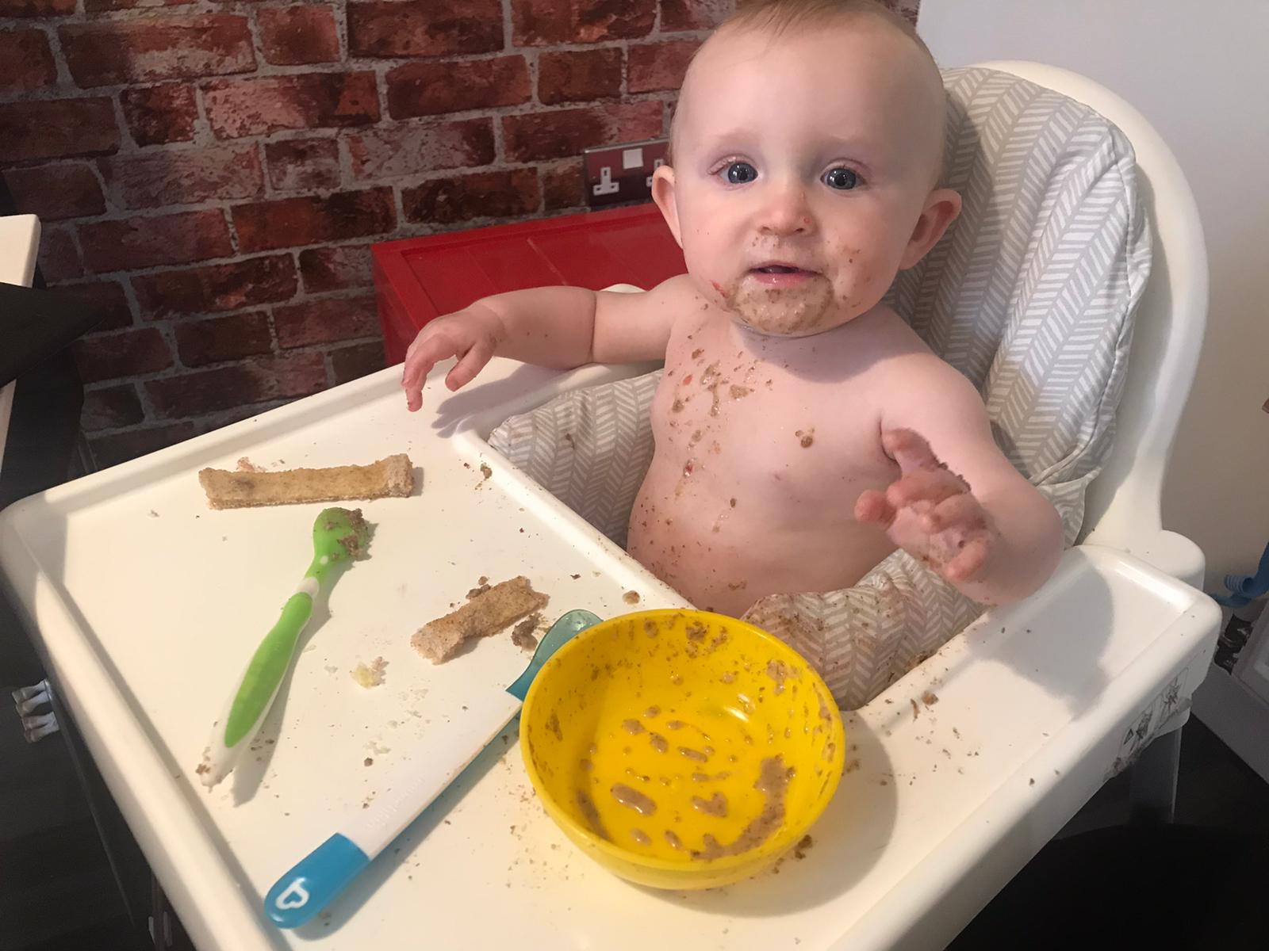
Eating, Drinking and Swallowing in schools
Meal and snack times are important for learning
They build communication skills.
They build physical skills like chewing
They build independence skills like feeding yourself
Mealtimes need to provide good nutrition and be enjoyable
Some students have eating and drinking problems because of medical and/ or developmental difficulties.
A team approach helps to ensure nutrition, safety and wellbeing.

Slide 6
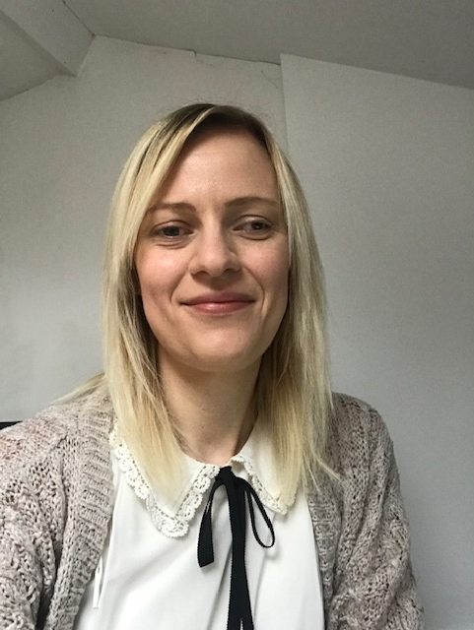
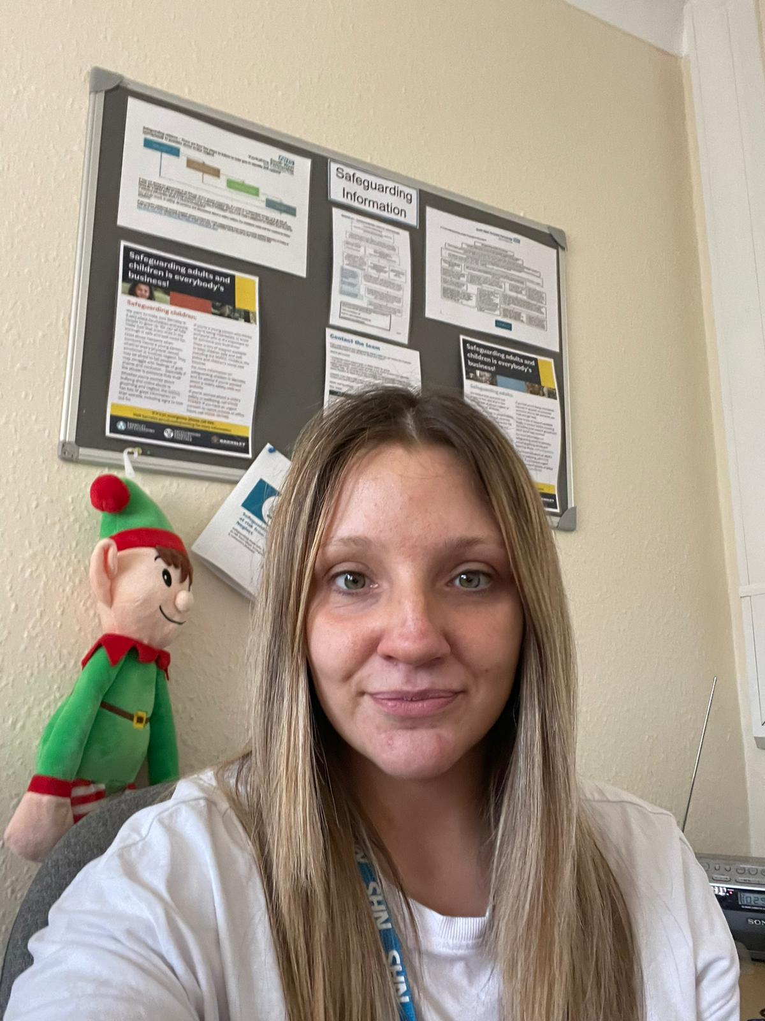
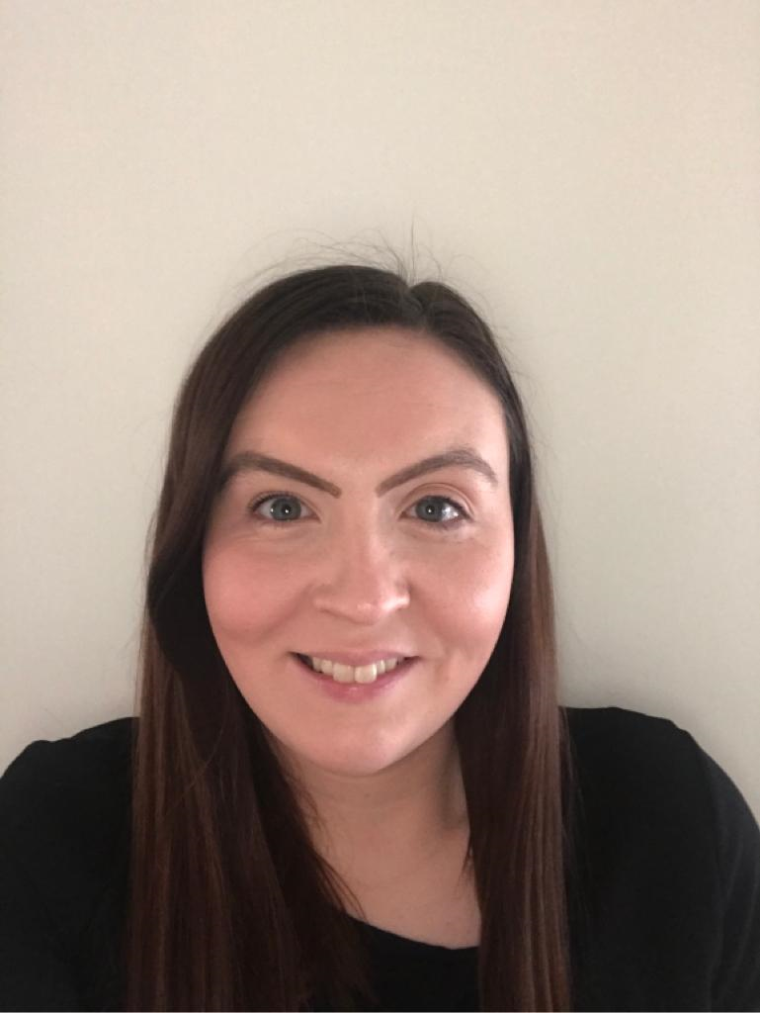
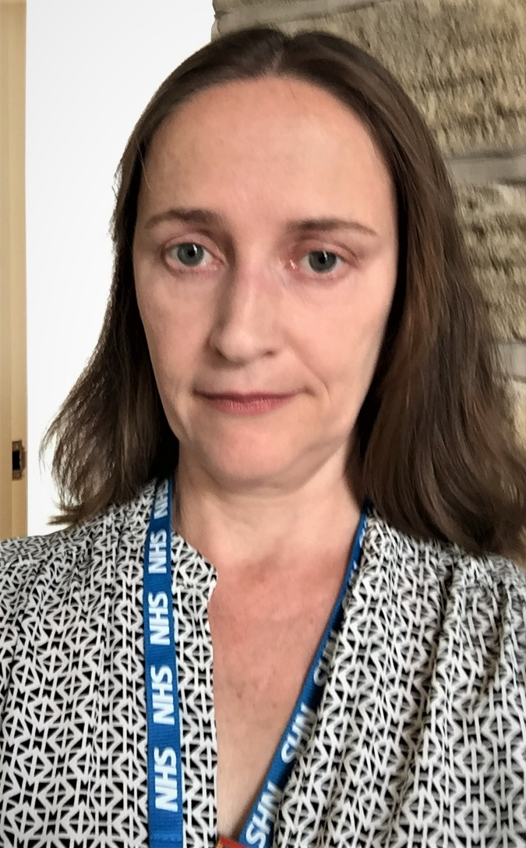
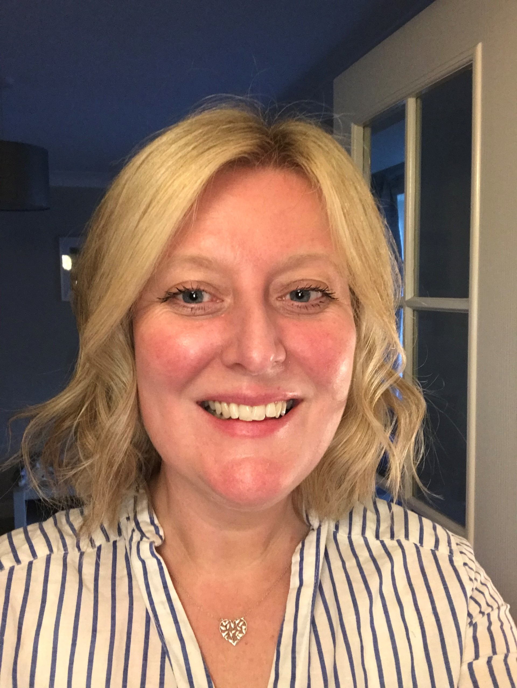

SALTs trained in Dysphagia
(eating and drinking problems)
Sian Simpson
Emily Singleton
Sally Butler
Amy McKinney
Rebecca Reid Elizabeth Aitchison
We provide assessment, diagnosis and advice if you’re worried
about a problem with eating, drinking or swallowing. We work as part
of a team to make sure children and families get the help they need

Slide 7
The team
CHILD
PARENTS
SALT
OT & PHYSIO
SCHOOL
NURSES
DOCTORS
DIETITIANS
KITCHEN
STAFF
CLASS STAFF
/SMSAs
SHORT STAY
STAFF

Slide 8

Role of SMSA / Feeding Partner
Help with eating and drinking at snack and mealtimes
Follow advice provided
Notice possible problems or if things are better and tell the team
Know how to help and respond to student’s communication
Know your legal responsibilities

Slide 9
Normal Eating and Drinking
Practical – Eat a Malteaser! Think about how you are eating it. Talk about what you did.
Think about
Previous experience – have you had one before?
Anticipation – What is your brain thinking? What are you going to do with the food?
Mouth Phase (oral preparatory and oral phase) – what are your cheeks, teeth, tongue, lips, saliva doing?
Swallow Phase – how does it work? Does anything move?
After the swallow
Notes:
Do malteaser activity – ask them to make any comments on chat/through feedback as to what they noticed

Slide 10
normal swallow animation
Youtube link
https://www.youtube.com/watch?v=-zPQjediqbQ

Slide 11
Students with Eating, Drinking and Swallowing Difficulties
How do you these difficulties affect feeding?
Talk to your partner
Developmental delay/ learning difficulties
Profound and multiple learning disabilities
Anatomical difficulties (e.g. cleft palate)
Attention/ arousal difficulties (epilepsy, illness)
Breathing difficulties
Sensory impairments (vision, hearing, other)
Cerebral palsy
Autism
Communication difficulties
Eating and drinking skills change over time!
Notes:
Ask them to spend 5 mins talking about this

Slide 12
What impacts
What impacts ED&S
Medical needs
Physical skills
Motor problems
Sensory problems
Learning
Psychological
Notes:
Talk through the previous list in relation to these factors
LD/PMLD – increased risk of motor problems or delays, co ordinating movements
CP = higher number of people with CP have difficulties with eating and drinking and can be down to the factors here (explain)
Children with specific medical conditions can also have impact on feeding – e.g. epilepsy, breathing problems, heart problems
Autism – can have issues with planning movements, medical but also can have sensory difficulties which also have an impact on eating and drinking – talking about hypersensitive, hypo and also rigidity of behaviour
Hearing/vision – sensory
Also have to think about children, family and our own experiences of eating and drinking. If children have had lots of problems with eating and drinking in the past it can affect how they view mealtimes, people trying to encourage them to eat. Feeding when children were younger may have been a stressful experience for the family or still continues to be

Slide 13
swallow animation
penetration and aspiration
Youtube link
https://www.youtube.com/watch?v=vuUdvDjv5x4

Slide 14

Signs of Problems – Red flags
Signs of distress when eating/ drinking
Coughing, choking, gagging, gipping
Change of colour and/or pained face
Sounds of difficulties breathing
Loss of voice or a gargling wet voice
Vomiting/ smell of vomit on breath after food/ drink. Uncomfortable after eating or drinking. Could be reflux
But remember some children have no visible signs. This is called “silent aspiration”.

Slide 15
Possible outcome of these problems
Unpleasant, not enjoyable mealtimes
Long-term aversion to eating and drinking
Weight loss and malnourishment/ dehydration – causes illness and problems learning
Choking
Chest Infections
Death

Slide 16

Assessment and Treatment

Slide 17
What We Do
Find out more about the student – their medical history and any previous eating and drinking problems
Talk to the family, young person if possible and school staff about what’s happening now
Complete an assessment of eating and drinking – observe student at home and/or school
We may use equipment like a stethoscope
May need to send a young person for more assessment
Talk to other professionals
Provide advice & training to home & to school staff to help keep children safe or build skills

Slide 18
Key Terms
Dysphagia: This is a medical term for eating drinking and swallowing difficulties.
Videofluoroscopy: A moving x ray of the swallow. This helps us to see food or drink in the mouth and throat. Children need to go to the Sheffield Children’s Hospital for this usually.
Aspiration: Food or drink ‘going down the wrong way’ into the wind pipe. It goes past the voice box into the lungs. This can result in chest infections and pneumonia.
Gastro-Oesophageal Reflux: Food or drink moving back up the oesophagus (food pipe) from the stomach. It can cause pain, discomfort and increased risk of feeding problems
IDDSI Levels: International dysphagia diet standardisation initiative. All children seen by a therapist now have levels to describe the texture of food and drink they are recommended to have. This is just one example of advice you need to follow.

Slide 19
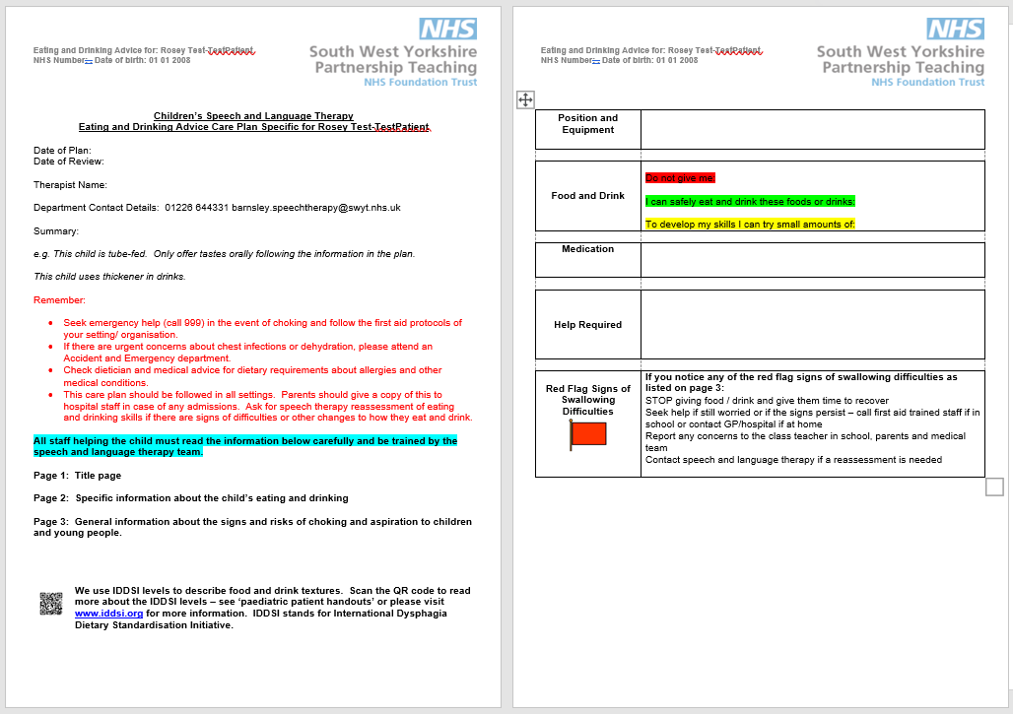

Slide 20
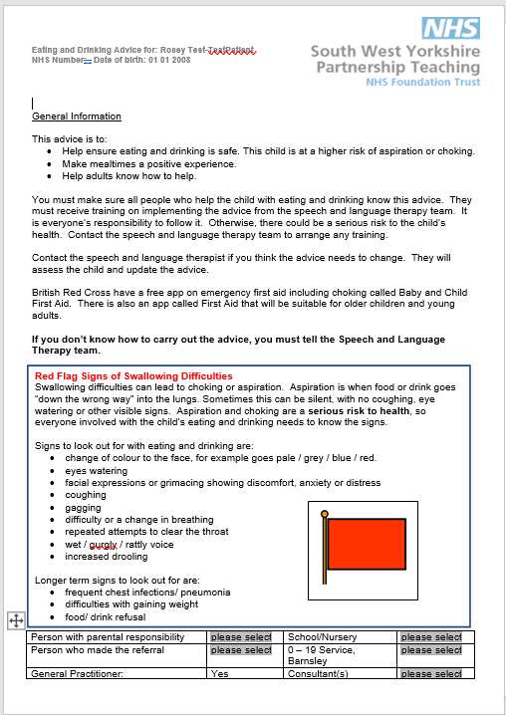

Slide 21
Advice - Textures
IDDSI levels – why use them?
International Dysphagia and Diet Standardisation Initiative (IDDSI) - Founded in 2013
Goal: develop terminology that is the same globally… definitions to describe texture modified foods and thickened drinks
Applies to individuals of all ages, in all schools and care settings and all cultures
Developed a framework which is a scale of 8 levels (0-7). Levels are identified by numbers, labels and colours.
0-4 refers to drinks; 3-7 refers to foods. Note that levels 3 & 4 overlap with both diet and fluids.

Slide 22
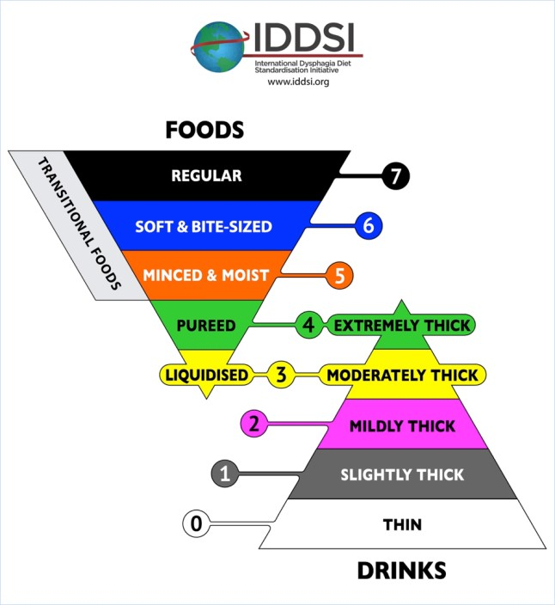

Slide 23

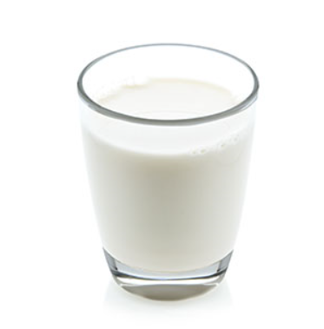


IDDSI Level Examples: drinks
Level 2
Mildly thick
effort to drink through a straw
Level 3: Moderately thick
Drink from cup/take from spoon – effort to have through wide straw
Level 4: Extremely thick
Take with spoon (can’t be drunk)
Level 0
Thin
Water
Level 1
Slightly thick
milk
Thickness of drinks can vary because of brand, temperature etc.
They need to be tested each time
If a child you are working with needs thickened drinks – we will show you how to test

Slide 24

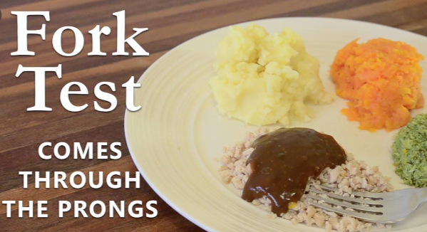
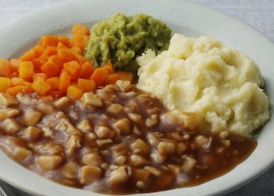
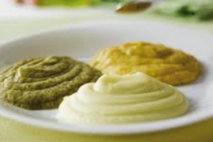
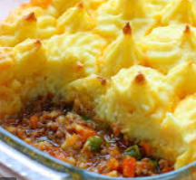

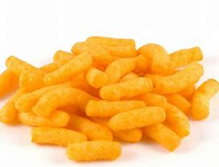
IDDSI Level Examples: food
Level 3
liquidised
A smooth runny texture
Level 4
Pureed
Smooth food that holds its shape
Level 5
Minced & moist
Lumps no more than 2mm. Can squash with tongue and fork
Level 6
soft & bite sized
8mm lumps or smaller can break down lump and mash with fork
Level 7
Easy to chew
Foods appropriate development level. Some foods still need avoiding
Level 7
Regular
Normal diet
Transitional foods
Melt in the mouth foods chewing practice
Notes:
Talk through and give examples of foods as you go
e.g. 3 = fruit puree, 4 = mash potato, 5 = finely mashed cooked veg, 6 = small lumps of veg 7 easy well = soft bread with spread, 7 regular = normal foods
Transitional e.g. wotsits. Remember to say that children are not like adults. They are developing skills. There may be foods that are still a problem such as those with skins or strings that we recommend be avoided

Slide 25
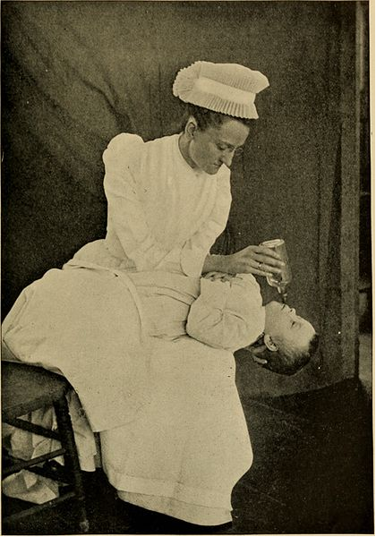
What is a good position for safe eating drinking and swallowing?

Slide 26
SALT Advice - positioning
Good Positioning
X Poor Positioning
Well supported
Upright
Head in midline
Avoid moving for 30 minutes after food/ drink
Reclined
Extended neck position
It is important that children are fed in the seating written on the feeding plan for safety.

Slide 27
SALT Advice
Utensils and equipment
Food and drink – IDDSI level allowed, amount allowed
Help required. Strategies you need to use
Signs that this child might be having difficulties.
Medical issues.
Speech and language therapy discharge children when we’ve done the work we need to do and advice is in place. If something changes, children need to be referred back to us.

Slide 28
Sharing Helpful Strategies That You Have Used

Slide 29
What You Can Do (General Strategies)
Find out about the student’s communication – what signs, key symbols, objects of reference do they need to use. What level of language should you be using?
Take time – do not rush. Find out what ways the student can let you know they want more, a different food
Always check the student’s feeding plan and follow it.
Share strategies that help with people who need to know
Put yourself into the child/student’s position – what would you like/not like to happen if someone was feeding you?
Use cues e.g. ‘open up’, tap shoulder, touch lip with spoon, describe food
Think about your setting – the noise, sound, light, people. Busy distracting environments can increase risk.

Slide 30
How you can help – do and don’ts
Expose children to different flavours and tastes at safe textures
Keep mealtime relaxed – don’t add pressure
Allow children to be messy and touch food. Feeling food helps them know what to do with it
Eat with children where you can. Models of other people eating is really important
Offer new foods a few times. It can take 15-20 exposures to food before children know if they like it or not
Keep mealtimes fun
Don’t
Use food as a reward for eating another
Rush
Use pressured language like ‘you need to eat this’

Slide 31
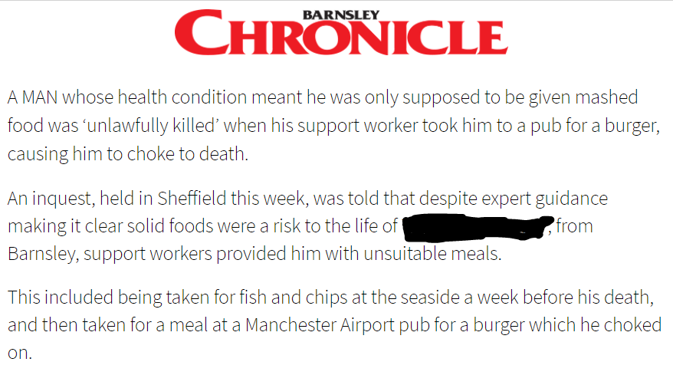
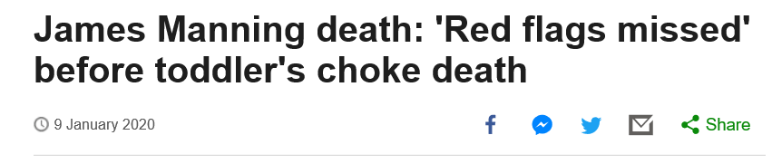
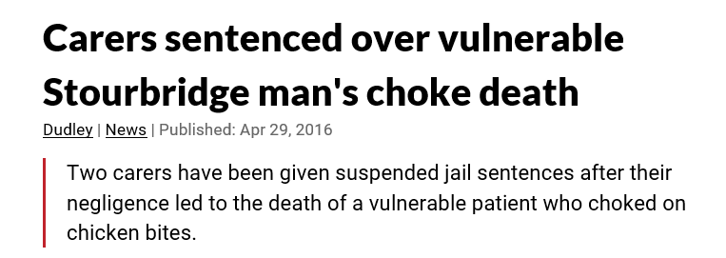
Your Legal Responsibilities – In the news
Not following advice can result in fatalities. Thankfully these cases are rare.
It can result in individuals/ organisations being fined or facing prosecution
It is important to know the advice to protect the person
It is also important that everybody involved knows the advice

Slide 32
Your responsibilities
You need to follow any advice given by professionals
Before agreeing to help a person with eating and drinking you must read the feeding plan – seek out the information you need
If you think something has changed – you need to let people know. Don’t offer new textures without checking.
If you spot red flag signs – tell the teacher and class staff. Contact speech therapy: 01226 644331

Slide 33
And finally…
Quiz and Feedback Form
This is to check you’ve taken in the info you need. It should take about 10 minutes
Put your name on the sheet
Do the quiz on your own and hand it in when you’ve done
Please fill in our feedback form
Contact us if something has changed/you want to change something
We are here to help – 01226 644331
We want to hear about what is working, as well as when things are not so good
Enjoy and bon appetit!

Slide 34
References and more information:
Eating drinking and swallowing competency framework (RCSLT)
https://www.rcslt.org/-/media/docs/EDSCF_29May_FINAL.pdf
Helpful tips for mealtimes and feeding:
www.childfeedingguide.co.uk
https://www.southwestyorkshire.nhs.uk/barnsley-childrens-speech-language-therapy-service/help-and-advice-for-you-at-home/learn-more-about-eating-and-drinking-skills/ - our departmental website
www.feedingmatters.org
Textures – IDDSI Levels
Great advice on textures and how to test at different levels plus food examples
www.iddsi.org
News
Toddler choking death related to large tonsils
https://www.bbc.co.uk/news/uk-england-sussex-51051450
Adult with lock-in syndrome choked on marshmallow
https://www.bbc.co.uk/news/uk-wales-50849739

Slide 35

Evidence:
Jeri A. Logemann, Evaluation and Treatment of Swallowing Disorders, Second Edition. Pro-ed 1998.
Nancy B. Swigert, The Source for Pediatric Dysphagia, Second Edition, LinguiSystems 2010

Slide 36


